Slide 1
NCCCS RISE Advisor Training
Lisa Key Brown
Sarah Deal
John Paul Black
Monty Hickman

Slide 2
Agenda
Changes in Developmental Studies
Corequisite Remediation
Where to find HS GPA in Colleague
RISE Placement Test
Transition Center and Crosswalk
Parent Class and Corequisite Class Contact/Credit Hours
Spring 2019 English and Math Placement Guide
New Colleague Screen
Spring 2019 Information
Math and English End of Module Cards
Scenarios

Slide 3
Changes in Developmental Studies
Semester Prior to RISE Implementation
First Semester of RISE
Students will be advised using multiple measures such as unweighted HSGPAs, SAT, ACT, CCRG, GED scores, HiSET (using the GED and HiSET scores are new)
If a student has a HSGPA within the last 10 years, the student will be placed based on unweighted HSGPA in 3 different areas:
curriculum course without a co-requisite
curriculum course with a co-requisite
transition center
If a student’s HSGPA is more than 10 years old, the student will be required to take the NROC Placement test in math and English
Last semester for DMA’s and DRE’s for the pilot colleges
NCDAP will no longer be used at the pilot colleges

Slide 5
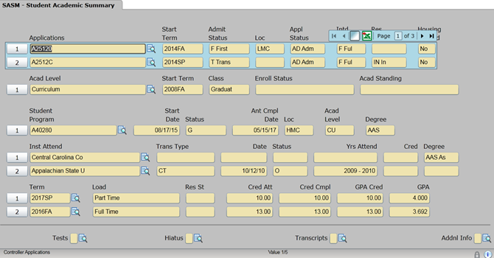
Where to find HS GPA? (Coming to AVISO soon!)
Go to SASM
Drill into high school by clicking on paper/magnifying glass at end of line of High School under the Institutions Attended section

Slide 6
Where to find HS GPA?
Drill into high school by clicking on paper/magnifying glass at end of line of High School under the Institutions Attended section

Slide 7
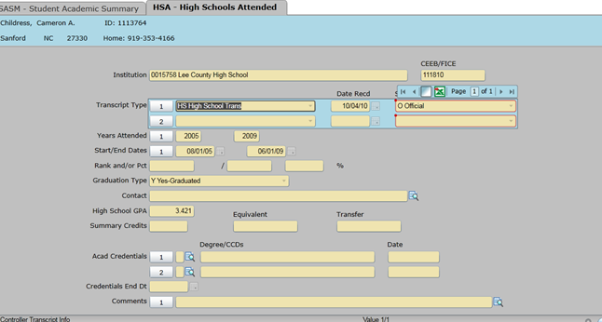
Where to find HS GPA?
See the years attended and HS unweighted GPA

Slide 8
RISE Placement Test
Administered only to
students who have been out of high school for more than 10 years
International students who did not graduate from a US high school
CIHS students
Students cannot take the RISE placement test if High School GPA is just below
2.2 to avoid transition center or if GPA is just below the range to avoid having to
take a co-req course.
Test Scores are valid for ten years. Students may retest on each level of the RISE placement test once for math and once for English.
If colleges currently have a retest process for students (such as a review session) this practice may continue with the RISE placement test.
Colleges should consider how they will communicate placement test results to students and the process for documenting the level of placement.

Slide 9
RISE Placement Test
Students will test in Math Tier 1 and Tier 2 (if 85% is made on Tier 1) to allow the students to take any math with a co-req or not.
Students will test in English Tier 1 and Tier 2 (if 75% is made on Tier 1) to allow the students to take ENG 111 with a co-req or not.
If students do not want to take the placement test, they will start in the transition center.

Slide 10
Transition Center and Crosswalk
DMA to EdReady units
DMA 010-030 -> EdReady units 1-8 ->Tier 1->Mat-060
DMA 010-050 - > EdReady units 1-12 -> Tier 2 ->Mat-070
DMA 010-080 -> EdReady units 1-17->Tier 3 ->Mat-080
DRE to EdReady units
DRE 097 ->EdReady units 1-6
DRE 098 -> EdReady units 1-10

Slide 11
1st RISE SEMESTER ADVISING GUIDE Transition Center in Curriculum
Transition Center in Curriculum (6 contact hours/3 credit hours)
Math - MAT 003 |  |  | The student may
Complete Unit 1-8 (Grade P1) DMA 010-030 |  |  | register for MAT 110 without co-req |  | OR register for MAT 143/152 with a co-req
Complete Unit 1-12 (Grade P2) DMA 010-050 |  |  | register for MAT 143/152 without co-req |  | OR register for MAT 121/171 with a co-req
Complete Unit 1-17 (Grade P3) DMA 010-080 |  |  | register for MAT 121/171 without co-req
English - ENG 002 |  |  | The student may
Complete Unit 1-6 (Grade P1) DRE 097 |  |  | register for ENG 111 with a co-req
Complete Unit 1-12 (Grade P2) DRE 098 |  |  | register for ENG 111 without a co-req

Slide 12
Parent Class and Co-requisite Class
 |  | Contact Hours | Credit Hours
Parent Class | Mat-110 | 4 | 3
Corequisite Class | Mat-010 | 2 | 1
Parent Class | Mat-121 | 4 | 3
Corequisite Class | Mat-021 | 3 | 2
Parent Class | Mat-143 | 4 | 3
Corequisite Class | Mat-043 | 3 | 2
Parent Class | Mat-152 | 5 | 4
Corequisite Class | Mat-052 | 3 | 2
Parent Class | Mat-171 | 5 | 4
Corequisite Class | Mat-071 | 4 | 2
Parent Class | Eng-111 | 3 | 3
Corequisite Class | Eng-011 | 3 | 2
Transition English – CU | Eng-002 | 6 | 3
Transition Math – CU | Mat-003 | 6 | 3

Slide 13
Reinforced Instruction for Student Excellence (RISE) Placement Guide
ENGLISH PLACEMENT GUIDE
 | Unweighted HS GPA | ACT | SAT | GED Mastery | CCRG Eng. Grade | Transition English Completion | Transition Grade | Dev Ed Course Completion | RISE Placement Test
Transition English | ≤ 2.199 | ENG ≤ 15 or READ ≤ 19 | ENG ≤ 479 | ≤ 170 | C, D, or F | --
ENG-111 with a Co-Req | 2.2 - 2.799 | ENG 16-17 or READ 20-21 | -- | -- | B | Unit 6 | P1 | DRE-097 | RISEE1≥75
ENG-111 without a Co-Req | ≥ 2.8 | ENG ≥ 18 or READ ≥ 22 | ENG ≥ 480 | ≥ 170 | A | Unit 10 | P2 | DRE 098 | RISEE2≥75

Slide 14
Reinforced Instruction for Student Excellence (RISE) Placement Guide
MATH PLACEMENT GUIDE
 | Unweighted HS GPA | ACT | SAT | GED Mastery | CCRG Math Grade | Transition Math Completion | Transition Course Grade | Dev Ed Course Completion | RISE Placement Test
Transition Math | ≤ 2.199 | Math ≤ 19 | Math ≤ 529 | ≤ 170 | -- | --
MAT-110 with a Co-Req | 2.2 - 2.799 | Math 20-21 | No Applicable Measure | No Applicable Measure -- | No Applicable Measure -- | No Applicable Measure -- | No Applicable Measure | No Applicable Measure | No Applicable Measure
MAT-110 without a Co-Req | ≥ 2.8 | Math ≥ 22 | Math ≥ 530 | ≥ 170 | C | Unit 8 | P1 | DMA 010-030 | RISEM1 ≥ 75
MAT-121 with a Co-Req | 2.2 - 2.799 | Math 20-21 | -- | -- | B | Unit 12 | P2 | DMA 010-050 | RISEM2 ≥ 75
MAT-121 without a Co-Req | ≥ 2.8 | Math ≥ 22 | Math ≥ 530 | ≥ 170 | A | Unit 17 | P3 | DMA 010-060 | RISEM3 ≥ 75
MAT-143 with a Co-Req | 2.2 - 2.799 | Math 20-21 | -- | -- | C | Unit 8 | P1 | DMA 010-030 | RISEM1 ≥ 75
MAT-143 without a Co-Req | ≥ 2.8 | Math ≥ 22 | Math ≥ 530 | ≥ 170 | B | Unit 12 | P2 | DMA 010-050 | RISEM2 ≥ 75
MAT-152 with a Co-Req | 2.2 - 2.799 | Math 20-21 | -- | -- | C | Unit 8 | P1 | DMA 010-030 | RISEM1 ≥ 75
MAT-152 without a Co-Req | ≥ 2.8 | Math ≥ 22 | Math ≥ 530 | ≥ 170 | B | Unit 12 | P2 | DMA 010-050 | RISEM2 ≥ 75
MAT-171 with a Co-Req | 2.2 - 2.799 | Math 20-21 | -- | -- | B | Unit 12 | P2 | DMA 010-050 | RISEM2 ≥ 75
MAT-171 without a Co-Req | ≥ 2.8 | Math ≥ 22 | Math ≥ 530 | ≥ 170 | A | Unit 17 | P3 | DMA 010-080 | RISEM3 ≥ 75
ENGLISH PLACEMENT GUIDE
 | Unweighted HS GPA | ACT | SAT | GED Mastery | CCRG Eng. Grade | Transition English Completion
Transition English | ≤ 2.199 | ENG ≤ 15 or READ ≤ 19 | ENG ≤ 479 | ≤ 170 | -- | --
ENG-111 with a Co-Req | 2.2 - 2.799 | ENG 16-17 or READ 20-21 | -- | -- | B | Unit 6
ENG-111 without a Co-Req | ≥ 2.8 | ENG ≥ 18 or READ ≥ 22 | ENG ≥ 480 | ≥ 170 | A | Unit 10

Slide 15
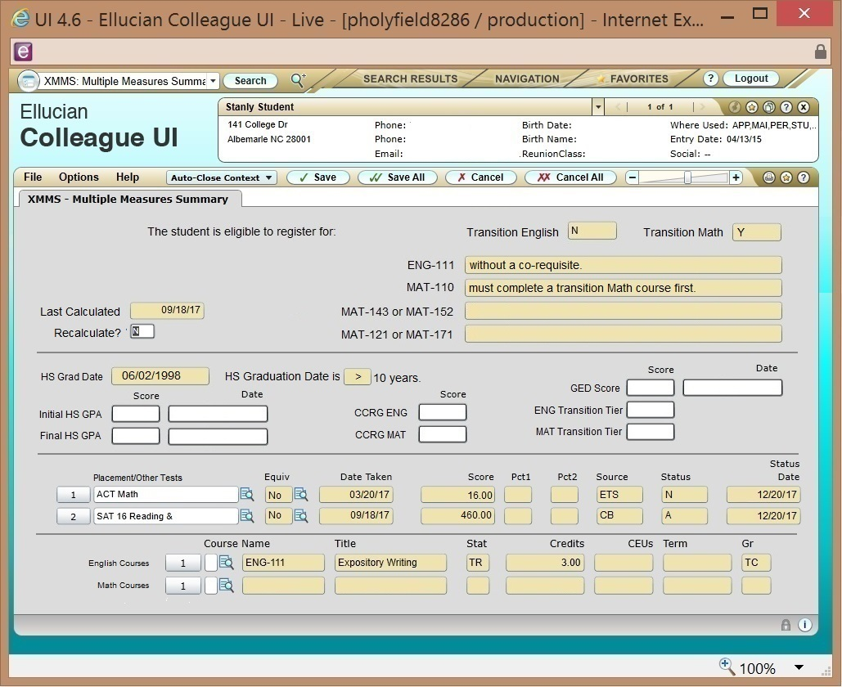
New Colleague Screen

Slide 16
XRISE Screen

Slide 17
XRISE Advisors View

Slide 18
1ST SEMESTER OF RISE Implementation
A student does not have HS GPA on file to register for ENG or MAT classes - put the student in other classes not ENG and MAT.
Use calendar year instead of graduation date in order to determine the 10 year rule for HS GPA.
Students who were previously enrolled and met Multiple Measure Waiver with HS GPA 2.6 or higher and had the 4th math will be allowed to take MAT and ENG courses without a co-req due to non-course credit already been awarded in Colleague. Faculty/Advisors will need to determine when a student entered the college. Multiple Measures was mandated Fall 2015.
New students in 1st RISE semester will need 2.8 unweighted HS GPA to earn non-course credit for co-requisite courses.

Slide 19
1st Semester RISE Implementation
Priority should be getting students enrolled in gateway math and English courses as soon as possible
AA students should take their English courses first.
AS/AE students should take their Math courses first.
Students who have earned an Associate or Bachelors degree do not have pre-requisite or co-requisite requirements and may enroll in any course.
After successful completion of each tier in a transition course, students will need advising to determine if the students’ program requirements have been satisfied and to review options for entering gateway courses with or without a co-requisite.

Slide 20
Math Course Card
English Course Card
Spring 2019 Math Course
You have completed or placed out of: | In Spring, 2019 you are eligible to take
DMA 010 & DMA 020 | MAT 003 – Transition Center
DMA 010, DMA 020 & DMA 030 | MAT 110 without a co-req | Or MAT 143 with co-req MAT 043 Or MAT 152 with co-req MAT 052
DMA 010 DMA 020 DMA 030 DMA 040 & DMA 050 | MAT 143/MAT 152 without a co-req | Or MAT 121 with co-req MAT 021 Or MAT 171 with a co-req MAT 071
DMA 010 DMA 020 DMA 030 DMA 040 DMA 050 DMA 060 DMA 070 & DMA 080 | MAT 121/MAT 171 without a co-req
Spring 2019 English Course
You have completed or placed out of: | In Spring 2019, you are eligible to take
DRE 096 | ENG 002 – Transition Center
DRE 097 | ENG 111 with a co-req ENG 011
DRE 098 | ENG 111 without a co-req

Slide 21
Scenarios

Slide 22
Tashana is an AE student possibly starting in fall 2020. Her FA has not been approved yet. She needs to take her required math and ENG 111.
TASHANA
HS | GPA | 2.715
transcript | Grad date | 6/12/09
 | 4th math? |  | yes (MAT-143 while CCP)
ACT/SAT/GED | Math |  | 23
 | ENG/Read |  | 16 / 19
CCRG/ Transition Ctr
Transfer credit/AP/IB
Dev Ed
Gateway MAT | MAT-171
Fall 2020 pilot:
In the spring, Tashana can take ENG 111 with a co-req due to her GPA and MAT 171 without a co-req due to her ACT math score of 23.
Semester prior to piloting RISE:
This semester, Tashana can take ENG 111 and MAT 171 due to her GPA. Also, her ACT math score of 23 could get her into MAT 171.
If she waits until next semester to begin, she would not need her math co-req due to her ACT score but she would need the ENG-011 co-req with her ENG-111.

Slide 23
Michelle is a paralegal student. How do you advise this student regarding ENG-111 for fall 2020?
MICHELLE
HS | GPA | 2.205
transcript | Grad date | 1/20/13
 | 4th math?
ACT/SAT/GED | Math
 | ENG/Read
CCRG/ Transition Ctr
Transfer credit/AP/IB
Dev Ed | DRE-096 |  | DRE-097
Gateway MAT
Fall 2020 pilot:
Michelle could take ENG 111 with a co-req in the fall 2020.
Semester prior to piloting RISE:
Michelle could take DRE 098 in spring19 and then she would be ready for ENG 111 without a co-req next semester OR take ENG 111 with a co-req next semester.

Slide 24
Larry is an Associate of Science student. What should he take if he starts in spring 2019?
LARRY
HS | GPA | 2.365
transcript | Grad date | 6/9/14
 | 4th math?
ACT/SAT/GED | Math
 | ENG/Read
CCRG/ Transition Ctr
Transfer credit/AP/IB
Dev Ed | DMA-010/020/030/040/050
Gateway MAT | MAT-171
fall 2020 pilot:
Larry could take MAT 171 in Fall 20 with a co-req.
Semester prior to piloting RISE:
Larry could take MAT 171 next semester with a co-req (4 hours) OR he could take DMA 060, 070, 080 (3 hours) in spring 2019 and could take MAT 171 next semester without a co-req.

Slide 25
Susan working toward an Associate in Arts. She is a part-time student and can only take one or two classes at a time. She needs to get her math requirement finished. What do you advise?
SUSAN
HS | GPA | 2.758
transcript | Grad date | 6/8/15
 | 4th math? |  | no
ACT/SAT/GED | Math
 | ENG/Read
CCRG/ Transition Ctr
Transfer credit/AP/IB
Dev Ed | DMA-010/020/030
Gateway MAT | MAT-143
Fall 2020 pilot:
She can take MAT 143 in FA 20 with a co-req class.
Semester prior to piloting RISE:
She can delay her MAT 143 until next semester and take it with the co-req class (3 hours) since she has DMA 010-030 credit OR she could take DMA 040 and 050 (2 hours) and take MAT 143 without a co-req next semester.

Slide 26
Ashley completed MAT-143 in SP16 with a “C”. She changed her major for SP19 to AS. How do you advise her for spring registration?
ASHLEY
HS | GPA | 2.430
transcript | Grad date | 6/7/09
 | 4th math? |  | no
ACT/SAT/GED | Math
 | ENG/Read
CCRG/ Transition Ctr
Transfer credit/AP/IB
Dev Ed | DMA-010/020/030/040/050
Gateway MAT | MAT-171
Fall 2020 pilot:
She could take MAT 171 with a co-req in the FA 20.
Semester prior to piloting RISE:
She could take DMA 060, 070, 080 (3 hours) and take MAT 171 without a co-req in the next semester OR she could take MAT 171 with a co-req (4 hours) next semester.

Slide 27
Sam is an AAS student who entered 2011FA. He has credit for DMA 010 and DMA 020. What should he do to complete his MAT requirement?
SAM
HS | GPA | 2.500
transcript | Grad date | 6/11/11
 | 4th math?
ACT/SAT/GED | Math
 | ENG/Read
CCRG/ Transition Ctr
Transfer credit/AP/IB
Dev Ed | DMA-010/020
Gateway MAT | MAT-110
Fall 2020 Pilot:
He will be required to take the MAT-110 with co-req because the graduation date is in the last 10 years and he did not qualify for multiple measures.
Semester prior to piloting RISE:
He should take DMA 030 and finish the prerequisites for MAT 110 OR he will be required to take the MAT-010 co-req with the MAT-110 next semester since his HS graduation date is in the last 10 years.

Slide 28
Brandy, an Associate of Arts student, has a HS GPA 2.85 but has a NCDAP ENG composite score of 125 and needs to take ENG 111 and MAT 143.
BRANDY
HS | GPA | 2.851
transcript | Grad date | 6/9/17
 | 4th math? |  | no
ACT/SAT/GED | Math
 | ENG/Read
CCRG/ Transition Ctr
Transfer credit/AP/IB
Dev Ed | DMA-040
Gateway MAT | MAT-143
Fall 2020 pilot:
Brandy can take ENG 111 and MAT 143 in SP19 without a co-req.
Semester prior to piloting RISE:
Brandy can take ENG 111 and MAT 143 next semester without a coreq OR due to the low scores on the placement test, the student may want to take DMAs and DREs to enhance her foundational skills.

Slide 29
Kerri is a returning student in the spring of 2019 who needs to take MAT 143 and ENG 111.
KERRI
HS | GPA | 2.192
transcript | Grad date | 6/11/11
 | 4th math? |  | no
ACT/SAT/GED | Math
 | ENG/Read
CCRG/ Transition Ctr
Transfer credit/AP/IB
Dev Ed | DMA-010/040, DRE-097
Gateway MAT | MAT-143
Fall 2020 pilot:
In FA 20, Kerri will take the math transition course because she does not meet any of the 3 cutoffs under transition center and will take ENG 111 with a co-req.
Semester prior to piloting RISE:
Kerri should take DMA 020, 030, 050 and DRE 098 so she can take MAT 143 and ENG 111 without a co-req in FA19. If she waits until next semester, Kerri will take the math transition course because she does not meet any of the 3 cutoffs under transition center and will take ENG 111 with a co-req.

Slide 30
Jane plans to enroll in Fall 2020 and take ENG 111 and MAT 171. Her HS GPA 2.59 and she graduated in 2014. ACT scores are ENG 18, READ 16, and MAT 22.
JANE
HS | GPA | 2.59
transcript | Grad date | 6/11/14
 | 4th math? |  | no
ACT/SAT/GED | Math |  | 22
 | ENG/Read |  | 18 / 16
CCRG/ Transition Ctr
Transfer credit/AP/IB
Dev Ed | DMA-010/040, DRE-097
Gateway MAT | MAT-171
Fall 2020 pilot:
Jane can take ENG 111 without a co-req because she meets the ACT ENG score, even though she doesn’t have the READ score. Beginning Spring 2019, ACT will be an OR versus a AND for ENG and READ. Jane can take any MAT without a coreq because of ACT of MAT 22.
Semester prior to piloting RISE:
Same advising.

Slide 31
Terry is a transfer student for the Fall 2020 term who has DMA 010-030 credit. He needs to take his required math and ENG 111.
TERRY
HS | GPA | 2.0
transcript | Grad date | 6/12/09
 | 4th math?
ACT/SAT/GED | Math |  | 20
 | ENG/Read |  | 16 / 19
CCRG/ Transition Ctr
Transfer credit/AP/IB
Dev Ed | DMA-010/020/030
Gateway MAT | MAT-110
Semester prior to piloting RISE:
Same advising.
Fall 2020 pilot:
Terry can take ENG 111 with a co-req due to his ACT ENG 16 score because it is an OR versus an AND for ENG and READ ACT scores. He can take MAT 110 without a co-req due to the credit for DMA 010-030.

Slide 32
Louisa is an AA student for the Fall 2020 term who needs to take her required math and ENG 111.
LOUISA
HS | GPA | 2.186
transcript | Grad date | 6/10/19
 | 4th math? |  | yes
ACT/SAT/GED | Math |  | 20
 | ENG/Read |  | 15 / 19
CCRG/ Transition Ctr | CCRG Math grade A CCRG English grade B
Transfer credit/AP/IB
Dev Ed
Gateway MAT | MAT-143
Fall 2020 pilot:
Louisa can take ENG 111 with a co-req due to her CCRG grade. She can take MAT-143, MAT-152, or MAT-171 without a co-req due to her CCRG grade.
Semester prior to piloting RISE:
Same advising.

Slide 33
Barbara is recently divorced and going back to school in spring 2019. She wants to get her AAS in Business Administration and then transfer to Franklin to finish her Bachelor’s degree. What do you advise her to take?
BARBARA
HS | GPA
transcript | Grad date | 6/12/89
 | 4th math?
ACT/SAT/GED | Math
 | ENG/Read
CCRG/ Transition Ctr
Transfer credit/AP/IB | MAT-060,070,080, ENG-102
Dev Ed
Gateway MAT | MAT-143
Fall 2020 Pilot:
Barbara can take ENG 111 with a co-req due to her ENG-102 . She can take MAT 143 without a co-req due to the credit for MAT 060-080.
Semester prior to piloting RISE:
Barbara can take ENG 111 with a co-req due to her ENG-102 or start this semester and complete DRE-098 so she would not need the co-req in the next semester. She can take MAT 143 without a co-req due to the credit for MAT 060-080.

Slide 34
Carter is an Associate of Engineering student beginning in the spring 2019 term. How do you advise him for the spring?
CARTER
HS | GPA 2.595
transcript | Grad date | 6/01/14
 | 4th math? |  | yes
ACT/SAT/GED | Math |  | 560
 | ENG/Read |  | 480
CCRG/ Transition Ctr
Transfer credit/AP/IB | MAT-271, MAT-152, BIO-111
Dev Ed | DRE-096/097
Gateway MAT | MAT-271
Fall 2020 pilot:
In the spring, Carter should take MAT-272 and go straight into ENG-111 without a co-req due to his GPA.
Semester prior to piloting RISE:
This semester, Carter should take MAT-272 and DRE-098 because his SAT scores are too old. Or, he can wait until next semester and go straight into ENG-111 without a co-req.

Slide 35
Jeremy dropped out of high school when he turned 16 during his 10th grade year. A year later, he earned his GED®. How do you advise him for the spring semester?
JEREMY
HS | GPA
transcript | Grad date | 6/01/15
 | 4th math?
ACT/SAT/GED | Math
172 | ENG/Read
CCRG/ Transition Ctr
Transfer credit/AP/IB
Dev Ed
Gateway MAT
Fall 2020 pilot:
In fall, he is eligible to go straight into ENG-111 and any math course without a co-req due to his GED mastery level score that is over 170.
Semester prior to piloting RISE:
This semester, Jeremy should take the NCDAP placement test to determine what classes he can take. However, if he waits until next semester, he is eligible to go straight into ENG-111 and any math course without a co-req due to his GED mastery level score that is over 170.

Slide 36
Questions?
If you have any questions, please call
Lisa Key Brown - lkbrown@cccc.edu
Sara Deal - shoff746@cccc.edu
John Paul Black - jpblack73@leniorcc.edu
Thank you for all you do!
Have a GREAT day!

Slide 37
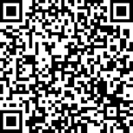
Please complete a RISE survey!
Post survey link: tinyurl.com/RISEpd2
tinyurl.com/RISEpd2

