Slide 1
Academic Advising
Professional Development: Fall 2021

Slide 2
Advising Resources
Look under My Courses:
Scroll down to Resources.
You will find the PCC Academic Advising Center & the PCC Transfer Center.
If you don’t have access, let me know.

Slide 3
Academic Advising Refresher

Slide 4
Making Changes
The following changes must be made before the 10% point.
Academic catalog of record
Course substitutions
Program of Study
To start these processes, use the proper forms posted on the PCC Advising Moodle site.
Failure to do so can lead to negative results for students.

Slide 5
WebAdvisor
Census date (also known as the 10% point)
When your courses begin, as students enter the course (seated or online), please be sure to put an “E” under the date of entry in WebAdvisor.
Do so before the census date. Do not wait.
Check your attendance everyday prior to the census date.
Once the census date comes and goes, if the student has not entered the course, list the student as a “no show” in WebAdvisor and alert Student Services.

Slide 6
Close them out of your Moodle course as well.
If you let the student enter the course beyond the census date, we cannot count the student for FTE purposes.
FTE is the basis for how we get funded as a college.

Slide 7
WebAdvisor: Final Grades
Once your course has ended, grade student work and submit your final grades through WebAdvisor.
Do this as soon as possible, meeting the final grades deadline set by the college registrar.
Delays in entering grades can disrupt the Student Services workflow.

Slide 8
Not On The Roster
If you have a student show up for your course who is not on the roster, do not allow them to stay in the course.
Ask them to go to Student Services to clear the matter up.
They must do so before entering the course.
If caught doing otherwise, the college could receive a reprimand from the state auditor.

Slide 9
Dropping Students (Instructor-Initiated)
Before dropping a student from your course, make sure you have completed an Early Alert in Aviso.
We must have documentation that shows an attempt was made to notify the student of their status.
To drop a student from your course, you must use the PCC Instructor Initiated Withdrawal Form 2020 posted on in the PCC Academic Advising Center. See the Advising Forms module.

Slide 10
Be prepared to list a last day of attendance for the student.
Do not wait too long to drop a student who has:
Not been attending class.
Not been turning in assignments (whether online or face-to-face courses).

Slide 11
If you have questions and are not sure if it’s time to drop the student, go to Student Services and talk with someone.
Together you can decide if you have a situation in which a student needs to be dropped.
If the drop is completed before the drop deadline, the student receives no grade (W).
This has no effect on their GPA.

Slide 12
If not, if they are dropped after the drop deadline, the student will receive a grade of “WF”.
It counts as an F and effects the student’s GPA.
The “WF” is a way for Student Services to see that the student has stopped participating in the course as opposed to just not performing well enough to pass (F).
Be sure to include the last date of attendance on the drop form.

Slide 13
Financial Aid
When a student has any financial aid questions, refer them to:
Meredith Beeman: Financial Aid Director
Do not try to answer financial aid questions. Always refer the student to Ms. Beeman & her staff.
Encourage students to prepare their financial aid applications early, for each academic year.

Slide 14
If a student wants to drop courses and they receive financial aid, suggest they go speak with someone in the financial aid office to see how it will affect them.

Slide 15
FERPA: Privacy
The Family Educational Rights and Privacy Act (FERPA) is a federal law that affords parents the right to have access to their children's education records, the right to seek to have the records amended, and the right to have some control over the disclosure of personally identifiable information from the education records.

Slide 16
What you can and can not discuss about a student’s education record is based FERPA law.
To see who you can and can not speak with, use the STRK mnemonic in Datatel.
When in doubt about FERPA regulations or if you have questions, please consult the Student Services staff.

Slide 17
Transcript Evaluations
From time to time, the Registrar’s office will send you transcript evaluations that require your immediate attention.
These outside courses could possibly count toward graduation requirements or pre-reqs. in your program.
No student wants to waste time and money taking courses that they have already taken.
These courses do not show up on their transcript until we as advisors complete the evaluation.

Slide 18
In order to determine what the course being transferred translates to here may require some detective work on your part.
Of course, ACA 111 from Craven CC is ACA 111 at PCC. The registrar inputs these automatically.
But what is NUTR 1000 from ECU? It’s EDU 153.
Course descriptions are very helpful in determining what a course translates to here.

Slide 19
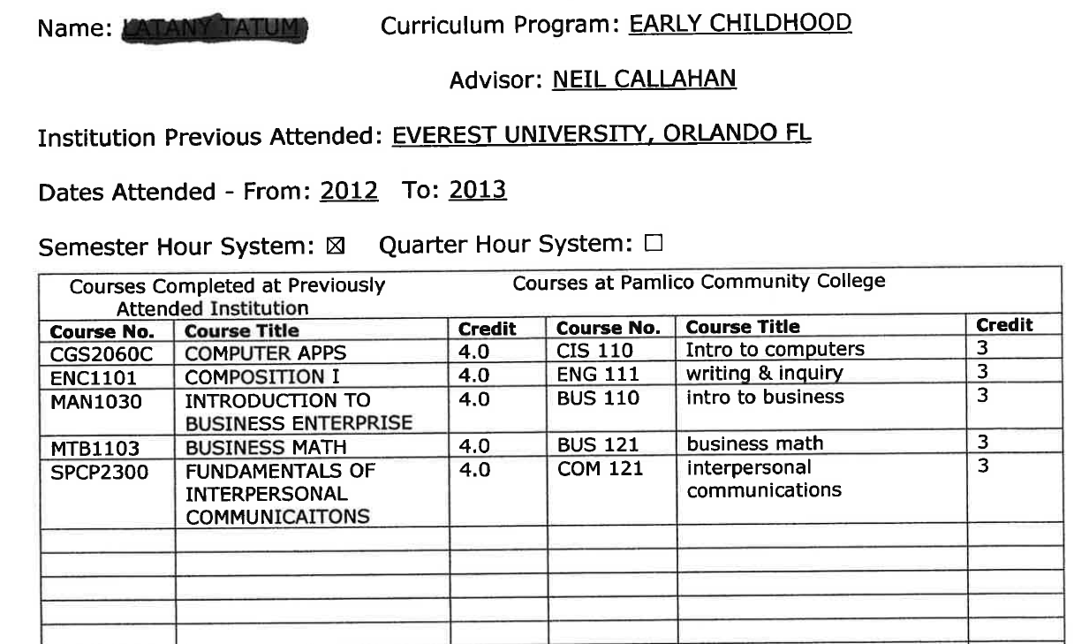

Slide 20
Be mindful of the number of credits the transferring course has.
If the course being transferred in is a 2 credit course, you cannot translate it to a 3 credit course equivalent at PCC.
If you require further help in determining what a course translates into, you can touch base with the subject matter expert.
If you cannot contact the subject matter expert, contact Neil Callahan for assistance.

Slide 21
Aviso Usage

Slide 22
Notes
Use the Aviso Notes function to document interactions with your students.
Document any type of information that would be useful to fellow college personnel.
This running record helps your fellow colleagues better understand the student.

Slide 23
Early Alerts
If you have a student in academic trouble and have exhausted all your means to contact them about the matter, be sure to access Aviso and enter an Early Alert.
Use your good judgement when deciding if you need to send an alert.
Your Early Alert will be received by someone in Student Services.

Slide 24
Remember: Student Services only knows there is a problem if you alert them to it.

Slide 25
Academic Advising Updates

Slide 26
Door Schedule With Office Hours
Post a schedule of your courses (days and times) and office hours on your door each semester.
This helps students to know better when to come by if they need to see you.

Slide 27
Review Your Moodle Course Set-Up
Make sure the dates for assignments in your Moodle course are correct and match the syllabus.
Design your course in such a way that assignments are easily identifiable within each course module.
Design your learning modules in a way that enhances course learning objectives.

Slide 28
Review Transcripts (Give Them Credit)
As you advise, or prepare to advise, your students, be sure to look over their transcript in Datatel Colleague using the PSPR function.
Once you have printed a copy of the student’s transcript information using the PSPR function, look for the section at the end of the document called “Other Courses.”

Slide 29
In this section, you may find courses the student has taken here or elsewhere that have not been filtered into the program requirement sections on the PSPR transcript.
Examine these courses carefully because you may find a course that can be used as a program requirement.
To know for sure, always refer to your Curriculum Standard, located on the NCCCS website.

Slide 30
If you have further questions about whether the course can be used as a program requirement, consult the college registrar, Gretchen Steiger (3011).

Slide 31
Grading
Grade course work and submit grades in Moodle on a regular basis.
It’s hard for a student to gauge their progress and to know if they are doing things correctly if you don’t grade their work on a regular basis.
Make sure final grades are entered correctly.
I have found instances where students earned a passing grade in a course but were issued a failing grade instead.

Slide 32
Putting Grades in the Gradebook
As you grade assignments and enter them into your Moodle gradebook, always enter a grade for each assignment.
Do not leave the grade blank.
If the student has not submitted an assignment on time and has permission to submit the assignment late, enter the grade of zero.

Slide 33
Once you receive the assignment, grade it, subtract the late fee, and enter the new grade.
If the student never follows through with submitting the work, you have that covered (you entered the zero). The student gets to keep it.
By having a grade entered in the gradebook, the student has a true sense of how well they are doing in a course.
This process also helps Aviso function, as it should.

Slide 34
False averages, due to non-grading or missing grades, can result in a student missing out on opportunities to correct course issues as early as possible.

Slide 35
Student Needs/Issues
If you feel one of your students has a need or an issue going on in their life that they may need some guidance to address beyond what you can do, please refer them to Student Services.
The Student Services staff can help students in many different areas.
Promise Place may always be an option as well.

Slide 36
RISE
RISE: Reinforced Instruction for Student Excellence
Students will be placed based primarily on their HS GPA (no 10-year expiration anymore).
We are currently using DMAs, DREs, and old developmental courses like ENG 085 and MAT 070 for English and Math placement as well.

Slide 37
Two modules in the PCC Academic Advising Center address RISE.
I have documents that explain how to convert old developmental courses as well. Just email me.
To better understand how PCC will handle the RISE process, review the PCC RISE Crosswalk document.

Slide 38
Important Course Dates: Fall 2021
Census/10%
Drop Date

Slide 39
Questions?

