Slide 1
Fall 2013 Advising Professional Development
Preparing for Pre-Registration & Spring Registration

Slide 2
PCC Advising Moodle Site

Slide 3
Transcript Evaluations
From time to time, the Registrar’s office will send you transcript evaluations that require your immediate attention.
These outside courses could possibly count toward graduation requirements or pre-reqs. in your program.
No student wants to waste time and money taking courses that they have already taken.
These courses do not show up on their transcript until we as advisors complete the evaluation.

Slide 4
Making Changes
The following changes must be made before the 10% point.
Academic catalog of record
Course substitutions
Program of Study
To start these processes, use the proper forms posted on the PCC Advising Moodle site.

Slide 5
Student Information
Before you register a student for classes,
Go over their “EVAL” on the Datatel Colleague System.
Check to see if the program advisor listed is correct.
Make sure the student’s Program of Study is correct.

Slide 6
Look over the courses to make sure the student has been given credit for all the courses they have taken toward graduation requirements.
Check to see if the academic catalog year listed is correct or the best it can be given the student’s situation.
After you look over the student’s “EVAL”, go into the student’s “STAC” and make sure everything looks good compared to the “EVAL”.

Slide 7
Courses Not In The Program of Study
Academic advisors should not place students in courses that are not part of the program of study in order to “give them hours.”
These courses will not be paid for by financial aid.
Be prepared for the occasional student who will ask you to do this.

Slide 8
If a student wishes to take a course that is not a part of their program of study for personal enrichment, you must explain the following things:
The course will not be paid for by financial aid.
The course will not count toward graduation requirements.
Be sure to fill out the PCC Course Acknowledgement Form in this instance.
Located on the PCC Advising Moodle site.

Slide 9
Financial Aid
When a student has financial aid questions, refer them to:
Jo Woolard
Susan Adams
The 12 hours Pell Grant Myth

Slide 10
If a student wants to drop courses and they receive financial aid, suggest they go speak with someone in the financial aid office to see how it will effect them.
The student already has to go to Student Services anyway to see the counselor to start the drop process.
Attendance verification:
Do not sign or verify the attendance of a student who has not been “attending” your course.
“Attending” can mean coming to scheduled class sessions and turning in assignments, among other things.

Slide 11
WebAdvisor
When your courses begin, as students enter the course (seated or online), please be sure to put an “E” under the date of entry in WebAdvisor.
Do so before the 10% point. Do not wait.
If the 10% point has passed and a student has not entered the course, go to Student Services and drop them from the course ASAP.

Slide 12
Dropping Students
Do not wait too long to drop a student who has:
Not been attending class.
Not been turning in assignments (whether online or face-to-face courses).
Never entered the course (whether online or face-to-face courses).

Slide 13
If you have questions and are not sure if it’s time to drop the student, go to Student Services and talk with someone.
Together you can decide if you have a situation in which a student needs to be dropped.

Slide 14
Early Alerts
If you have a student in academic trouble and have exhausted all your means to contact them about the matter, be sure to fill out the Early Alert form and take it to Cristy Lewis.
The form is located on the PCC Advising Moodle site.
Read over the other Early Alert information located on the site.

Slide 15
In the case of online instructors who are off-site and cannot come to Student Services, they must email the form via Campus Cruiser email only.
As a result of FERPA law, this form should not be submitted through Outlook (Office 365) emails.
Because these emails are public, we would be violating the student's right to privacy.
You can use Campus Cruiser email to send this document because the system is secure and not public.
Send the form to cristy_lewis@mailcruiser.com.

Slide 16
Online Readiness
Students who have not taken online courses at PCC in the past or passed CIS 110 recently must take the Online Readiness test in order to enrolled in CIS 110 or partial internet and online course.
Check the student’s score before placing them in these types of courses.
Look under the Datatel Colleague section of the PCC Advising Moodle site to see how to do so.

Slide 17
Campus Cruiser Correspondence
As you advise and teach students, please reinforce the importance of checking Campus Cruiser email.
PCC communicates many important announcements through the Campus Cruiser email system (financial aid info, for example).
Not checking these emails can result in many different types of inconveniences for students.

Slide 18
DRE Update
DRE update:
Marti Hunter

Slide 19
NCCCS Math Course Improvement Program (CIP)
Met Sept 5, 2013 and came to a unanimous decision:
Eliminate the assessments for DMA 070 and 080 from the NC Developmental Assessment Program.

Slide 20
Ask College Board to break the NC DAP into three possible tests in order to give colleges flexibility for testing and re-testing:
DMA 010-030
DMA 040-060
DMA 010-060
Each of the three possibilities would cost one ACCUPLACER unit.
Colleges could also choose to offer a paper/pencil version of any individual assessment for re-testing purposes.

Slide 21
Enact a new placement policy in which:
A student who successfully completes or places out of all modules up to and including DMA 060 may enroll in any curriculum math course, including MAT 161 and 171.
A student who intends to enroll in MAT 161/171 who does not place out of the DMA 060 assessment would have to enroll in and successfully complete DMA modules 060, 070, and 080 prior to enrolling in MAT 161 and 171.

Slide 22
Proposed New Courses Fall 2014
Course # | New Course Title | Summary of New Course
MAT 143 (Replaces MAT 140) | Quantitative Literacy | Title: Quantitative Literacy Prerequisites: DMA 010, DMA 020, DMA 030, DMA 040, DMA 050, and DRE 098 Hours: Class 2, Lab 2, Credit 3 New course description New Student Learning Outcomes
MAT 152 (Replaces MAT 151) | Statistical Methods I | Title: Statistical Methods I Prerequisites: DMA 010, DMA 020, DMA 030, DMA 040, DMA 050, and DRE 098 Hours: Class 3, Lab 2, Credit 4 New course description New Student Learning Outcomes

Slide 23
Proposed New Course: MAT-099
MAT 099 Math Skills Support Class 0 Lab 2 Credit 1
This course uses a variety of instructional strategies to provide opportunities for students to build a stronger foundation for success in their co-requisite math course. Emphasis is placed on pre-requisite skills as well as on the co-requisite course concepts, skills, vocabulary and definitions necessary to master the appropriate student learning outcomes. Upon completion, the student should be able to apply mathematical concepts and critical thinking skills to solve problems relevant to the student's co-requisite math course.
Minimum State Pre-reqs: None
Minimum State Co-reqs: MAT 143 or MAT 152 or MAT 171
Date instituted – TBD
Meeting in April 14 to discuss.

Slide 24
Points to ponder:
MAT 099 would be a developmental course by number. By retaining the MAT (not DMA) prefix, colleges with separated developmental/curriculum math would have a way to direct oversight of the course to the Math Division.

Slide 25
Veterans cannot get support for developmental classes that do not meet in a face to face setting. Although this is certainly an issue now, our own NCCCS administrators as well as administrators across the country are trying to work with the VA to amend this situation.
MAT 100 is a non-transfer credit number. We do not want this course to be considered for transfer credit of any type; however such numbering would mean AA/AS students cannot get financial aid or VA for it. Hence, the developmental number seems to be the only way to go.

Slide 26
Why MAT 099?
It is being considered in response to the Multiple Measures provision: Colleges may require students with a GPA <3.0 enrolling in MAT 151, 155, 161, or 171 to take a supplemental math lab as a co-requisite.
It would be a co-req for MAT 152 and MAT 171 for students with a high school GPA in the range of 2.6-3.0.

Slide 27
A college could elect to include the course in their catalog. Currently colleges would add a field to TSUM to indicate that the GPA is in the indicated range.
Most colleges are already doing this just to indicate the GPA of 2.6. Ultimately, the state may have an indicator that will be in place from the HS transcript evaluation.
If a student had the minimum required GPA of 3.0, he would receive non-course credit for MAT 099.

Slide 28
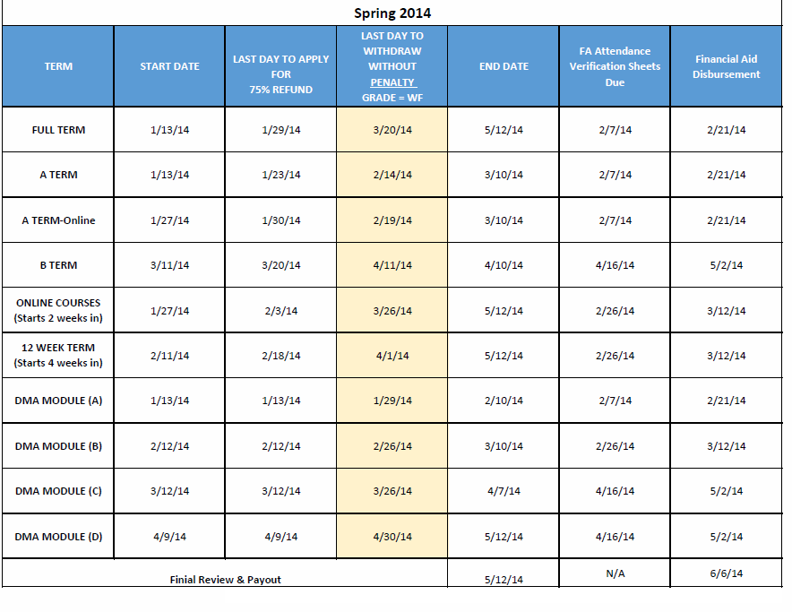
Important Course Dates: Spring 2014

Slide 29
Questions?

