Slide 1
Rise Advisor Training
Laura kalbauGH – NC Student success center, ncccs

Slide 2
Remember, RISE is ….
Placing students into one of three pathways based primarily on their HS GPA
Replacing prerequisite remediation with co-requisite remediation whenever possible
The goal is to increase the number of students that successfully pass a gateway math and English within two years

Slide 3
Placement Criteria
Unweighted GPA
GED
HiSET
Associate’s or Bachelor’s degree
ACT/SAT
AP/IB/Cambridge
Transfer credit
Career & College Ready Graduates*
When can students take the RISE Placement Test?
This Photo by Unknown Author is licensed under CC BY
Notes:
Unweighted HS GPA is the first placement measure but we need to check other measures to see if the student can place higher. Only students who are outside the 10 year from graduation window or who legitimately don’t have a HS GPA (foreign high schools, GED. adult high school. Etc.) are able to take the RISE Placement Test. No one else is able to test.

Slide 4
RISE GPA Placement
HS GPA is the first placement measure
Within 10 years of graduation
Any US high school
No 4th math requirement
HS GPA 2.8+
HS GPA
< 2.2
If ACT score within 2 points of benchmark then gateway course with co-requisite
HS GPA
2.2-2.799
Gateway math or English without
co-requisite
If ACT benchmark score then math or English gateway without co-requisite
Transition Math Course and/or Transition English Course
Gateway math or English with a
co-requisite
Notes:
First placement. GPA is now the number one placement measure. Students who have graduated within 10 years of coming to the college, from any US high school, will be placed by their unweighted high school GPA. No 4th math is currently required – unlike our previous multiple measures policy. Students with a GPA of 2.8 or higher are fully college ready and can take any gateway math or English course without a corequisite. For students with GPAs between 2.2 and 2.799, they will take gateway math or English with a corequisite unless they have some other placement measure, like an ACT or SAT score, transfer credit, etc. Students with GPA below 2.2 will generally take the Transition English and Math courses. They can place out with other measures like the 2.2-2.799 students with the additional option of taking the gateway English and math with a corequisite if their ACT scores are within 2 points of the benchmark. For example, the math benchmark is 22. A student with GPA less than 2.2 can still take the gateway math course with a corequisite if their ACT score is 20 or 21. Otherwise, without some other placement criteria, that student will go to the Transition Math course before taking gateway math.

Slide 5
RISE Placement Credit
HS GPA 2.8+
HS GPA
< 2.2
No NC credit
HS GPA
2.2-2.799
NC credit
MAT 003
ENG 002
NC credit
MAT 003
ENG 002
NC Credit
MAT 010, 021, 043, 052, 071
ENG 011
Notes:
When a student is admitted, their HS GPA will automatically give them non-course credit as appropriate. This is often viewed in the STAC screen. A HS GPA of 2.8 or higher will earn the student non-course credit for the Transition Math course, MAT 003, and the Transition English course, ENG 002. In addition, these students will get NC credit for all of the math and English corequisite courses. Those are MAT 010, MAT 021, MAT 043, MAT 052, MAT 071, and ENG 011. Students between 2.2 and 2.799 will get only credit for MAT 003 and ENG 002. This will allow the students to register for the gateway math and English but the lack of credit for the corequisites will force the student to take them. Of course, students with HS GPA below 2.2 will get no NC credit due to their GPA alone. They may have other placement measures that will earn them credit though.

Slide 6
RISE Placement Guide - ENGLISH
ENGLISH PLACEMENT GUIDE
 | Unweighted HS GPA | ACT | SAT | GED | CCRG English Credit | Transition English Grade | DRE Course Credit | RISE Placement Test
Transition English | ≤ 2.199 | ENG ≤ 15 or READ ≤ 19 | ENG ≤ 479 | ≤ 170 |  | --
ENG-111 with a Co-Requisite | 2.2 - 2.799 | ENG = 16 -17 or READ = 20-21 | -- | -- | Tier 1 credit | P1 | DRE-097 | RISEE1≥75
ENG-111 without a Co-Requisite | ≥ 2.8 | ENG ≥ 18 or READ ≥ 22 | ENG ≥ 480 | ≥ 170 | Tier 2 credit | P2 | DRE 098 | RISEE2≥75
Notes:
If all of the criteria in the first row of this chart are true, then the student’s placement begins in Transition English (ENG 002). From there, the student’s record should be reviewed to see if any of the other items can place the student higher. For instance, if this is a continuing student who has previously earned credit for DRE 097 then she can register for ENG 111 with a coreq. OR if the student has an ACT English score of 18 then she can register for ENG 111 without a coreq. Any one of the measures listed in the second or third rows can “bump” the student to that row’s placement.

Slide 7
RISE Placement Guide - MATH
MATH PLACEMENT GUIDE
 | Unweighted HS GPA | ACT | SAT | GED Mastery | CCRG Math Credit | Transition Course Grade | DMA Course Credit | RISE Placement Test
Transition Math | ≤ 2.199 | Math ≤ 19 | Math ≤ 529 | ≤ 170 | -- | -- | -- | --
MAT-110 with a Co-Requisite | 2.2 - 2.799 | Math = 20-21 | -- | -- | -- | -- | -- | --
MAT-110 without a Co-Requisite | ≥ 2.8 | Math ≥ 22 | Math ≥ 530 | ≥ 170 | Tier 1 | P1 | DMA 010-030 | RISEM1 ≥ 75
MAT-121 with a Co-Requisite | 2.2 - 2.799 | Math = 20-21 | -- | -- | Tier 2 | P2 | DMA 010-050 | RISEM2 ≥ 75
MAT-121 without a Co-Requisite | ≥ 2.8 | Math ≥ 22 | Math ≥ 530 | ≥ 170 | Tier 3 | P3 | DMA 010-060 | RISEM3 ≥ 75
MAT-143 with a Co-Requisite | 2.2 - 2.799 | Math = 20-21 | -- | -- | Tier 1 | P1 | DMA 010-030 | RISEM1 ≥ 75
MAT-143 without a Co-Requisite | ≥ 2.8 | Math ≥ 22 | Math ≥ 530 | ≥ 170 | Tier 2 | P2 | DMA 010-050 | RISEM2 ≥ 75
MAT-152 with a Co-Requisite | 2.2 - 2.799 | Math = 20-21 | -- | -- | Tier 1 | P1 | DMA 010-030 | RISEM1 ≥ 75
MAT-152 without a Co-Requisite | ≥ 2.8 | Math ≥ 22 | Math ≥ 530 | ≥ 170 | Tier 2 | P2 | DMA 010-050 | RISEM2 ≥ 75
MAT-171 with a Co-Requisite | 2.2 - 2.799 | Math = 20-21 | -- | -- | Tier 2 | P2 | DMA 010-050 | RISEM2 ≥ 75
MAT-171 without a Co-Requisite | ≥ 2.8 | Math ≥ 22 | Math ≥ 530 | ≥ 170 | Tier 3 | P3 | DMA 010-080 | RISEM3 ≥ 75
ENGLISH PLACEMENT GUIDE
 | Unweighted HS GPA | ACT | SAT | GED Mastery | CCRG Eng. Grade | Transition English Completion
Transition English | ≤ 2.199 | ENG ≤ 15 or READ ≤ 19 | ENG ≤ 479 | ≤ 170 | -- | --
ENG-111 with a Co-Req | 2.2 - 2.799 | ENG 16-17 or READ 20-21 | -- | -- | B | Unit 6
ENG-111 without a Co-Req | ≥ 2.8 | ENG ≥ 18 or READ ≥ 22 | ENG ≥ 480 | ≥ 170 | A | Unit 10
Notes:
This chart works the same as the English chart. If all of the measures in the first row are met without any other placement then the student begins in the transition math courses (MAT 003). The advisor should determine what math is required for the student’s program and look at those rows. If any measure is met in one of those rows then the student can take the course as noted, either with a coreq or without a coreq.

Slide 8
TRANSITION COURSES
Unweighted high school
GPA < 2.2
Curriculum | Basic Skills
3 credits, 6 contact hours | 8 contact hours
Cost to the student | Free to the student
Counts toward financial aid f/t | Does not count toward financial aid
CIHS students can take this course | Not eligible for CCP students
Typically one semester | Student may exit early
If ACT score within 2 points
of benchmark then gateway course with co-requisite
Transition Math and/or
Transition English
Basic Skills or Curriculum
Notes:
Each college needs to determine the best place to house the transition courses. The college may choose to teach only in curriculum, only in basic skills, or use a combination of both.

Slide 9
Transition English Course - ENG 002
Mastery of Tier 1
Mastery of Tier 2
ENG 111
with co-requisite
ENG 111
without
co-requisite
Notes:
The students outside of the 10 year limit for HS GPA and any student who does not have a US HS GPA (foreign students, GED students, etc.) will take the RISE Placement Test. This test mirrors the Transition Math and Transition English courses. The Tiers in the courses correspond to sections of the placement tests. Any options available to a student upon completion of a Tier, either in the course or on the test, are the same. Let’s look at the Transition English course – ENG 002 – first. It has two Tiers. If a student masters Tier 1 in the course or passes the English Tier 1 Placement Test he is eligible to then take ENG 111 with the corequisite – ENG 011. This is great! The student has enough knowledge to attempt ENG 111 and will have excellent, just in time, targeted help to be successful in the course. If the student runs out of time and can’t complete Tier 2 in the course we want that student to go to ENG 111 and take ENG 011 with it. They should not be encouraged to return to the Transition English course. If the student has time, he can complete Tier 2 in Transition English. If that is the case, the student will be able to take ENG 111 without the corequisite. Likewise, if the student masters the English Tier 2 Placement Test he can take ENG 111 without a corequisite. A couple quick notes on the RISE Placement Tests – the tests are sequential and a student is not allowed to move to the next Tier unless he earns the mastery score of 75 on the current Tier. Students are allowed to retest one time on each Tier.

Slide 10
Transition Math Course - MAT 003
Mastery of Tier 1
Mastery of Tier 3
MAT 121 or
MAT 171
without co-requisite
Mastery of Tier 2
MAT 110
without co-requisite
MAT 143 or
MAT 152
without co-requisite
MAT 143 or
MAT 152
with co-requisite
MAT 121 or
MAT 171
with co-requisite
Notes:
Moving onto math! I’m going to stop trying to parallel the test to the course because of the complexity of the Tiers here. Just remember that mastering a Tier on the test results in the same options as mastering the Tier in the Transition course. There are three Tiers in the Transition Math course – MAT 003. Upon mastering Tier 1, students are able to take MAT 110 without the corequisite. But, they are also able to take MAT 143 or MAT 152 with their corequisite courses – MAT 043 or MAT 052. This is huge! Students don’t have to return to MAT 003 to complete more Tiers if their program math is any of those three. We hope students will complete through Tier 2 in one semester and that would allow them to still take MAT 110 without the corequisite but also MAT 143 and MAT 152 with their corequisites. In addition, they are now able to take MAT 121 or MAT 171 with their corequisites – MAT 021 and MAT 071. So, by completing through Tier 2 a student is able to take any gateway math course! Finally, mastery of Tier 3 will allow a student to take any gateway math course without a corequisite. But again, taking the course with a corequisite is a good outcome. They will not spend another semester in the prerequiste course but will have the opportunity to earn gateway course credit with the just in time, targeted help that will support them in the effort.

Slide 11
Co-Requisite Courses
Parent Class | Contact Hours | Credit Hours |  | Co-Req Class | Contact Hours | Credit Hours
MAT 110 | 4 | 3 |  | MAT 010 | 2 | 1
MAT 121 | 4 | 3 |  | MAT 021 | 3 | 2
MAT 143 | 4 | 3 |  | MAT 043 | 3 | 2
MAT 152 | 5 | 4 |  | MAT 052 | 3 | 2
MAT 171 | 5 | 4 |  | MAT 071 | 4 | 2
ENG 111 | 3 | 3 |  | ENG 011 | 3 | 2
Notes:
I’ve been talking about the corequisite courses but here are the details. Each course is 1 or 2 credit hours with 2 to 4 contact hours. The naming convention should facilitate the connection to the parent course. For instance, MAT 152, Statistics, is a 4 credit hour, 5 contact hour course with a corequisite course, MAT 052 that is a 2 credit hour 3 contact hour course. This means the student who requires the corequisite will be signing up for both courses totaling 6 credit hours and 8 contact hours. That’s a lot of math! But it gives students the opportunity to take MAT 152 who might have had to spend several semesters taking developmental coursework before doing so. In addition, the corequisite class will provide valuable support to the student while taking advantage of the opportunity.

Slide 12
Crosswalk for Current Students
DMA to MAT 003 Tiers
DMA 010-030 → MAT 060 → MAT 003 Tier 1
DMA 010-050 → MAT 070 → MAT 003 Tier 2
DMA 010-080 → MAT 080 → MAT 003 Tier 3
DRE to ENG 002 Tiers
DRE 096 → no Tier credit
DRE 097 → ENG 002 Tier 1
DRE 098 → ENG 002 Tier 2
Notes:
Of course we have to have a crosswalk for current students to translate to RISE placement. This is a rough approximation that may or may not mirror state and local course requisites. But, it allows us to help students make the transition. DMA 010-030 roughly equates to MAT 003 Tier 1. DMA 010-050 equates to MAT 003 Tier 2. And, all DMA modules, 010-080 equates to Tier 3 for placement purposes. In English, we have no translation for DRE 096. DRE 097 is roughly equivalent to ENG 002 Tier 1 and DRE 098 is being equated to ENG 002 Tier 2. This will be important for continuing students as we want to give them the highest placement possible.

Slide 13
Advising Considerations to Remember
New students will be placed by GPA or the RISE Placement Test
Check HS GPA and place accordingly
To determine if higher placement is possible
Check for DMA or DRE credit
Check for ACT/SAT or other test placement
Check for MAT 003 or ENG 002 credit
Check for Associate or Bachelor degree
Continuing students will need to be re-evaluated to determine next steps based on RISE guidelines
If previously required developmental work has not been completed, GPA or other placement criteria may now allow the student to take gateway courses with or without a co-requisite
Colleges will want to determine how to ensure that continuing students are informed of the changes

Slide 14
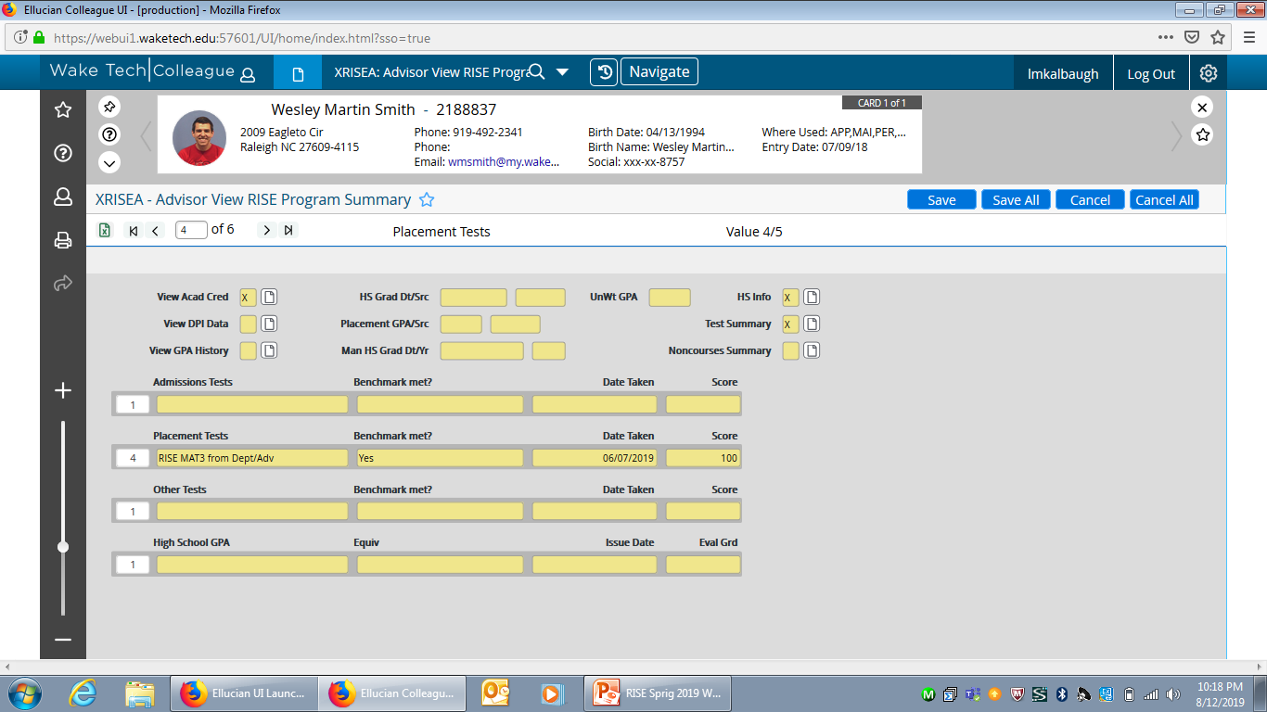
XRISEA Screen
Notes:
The XRISEA screen brings testing, GPA, and other information together on one screen. Additionally, you can quickly get to STAC and HSA through drill downs.

Slide 15
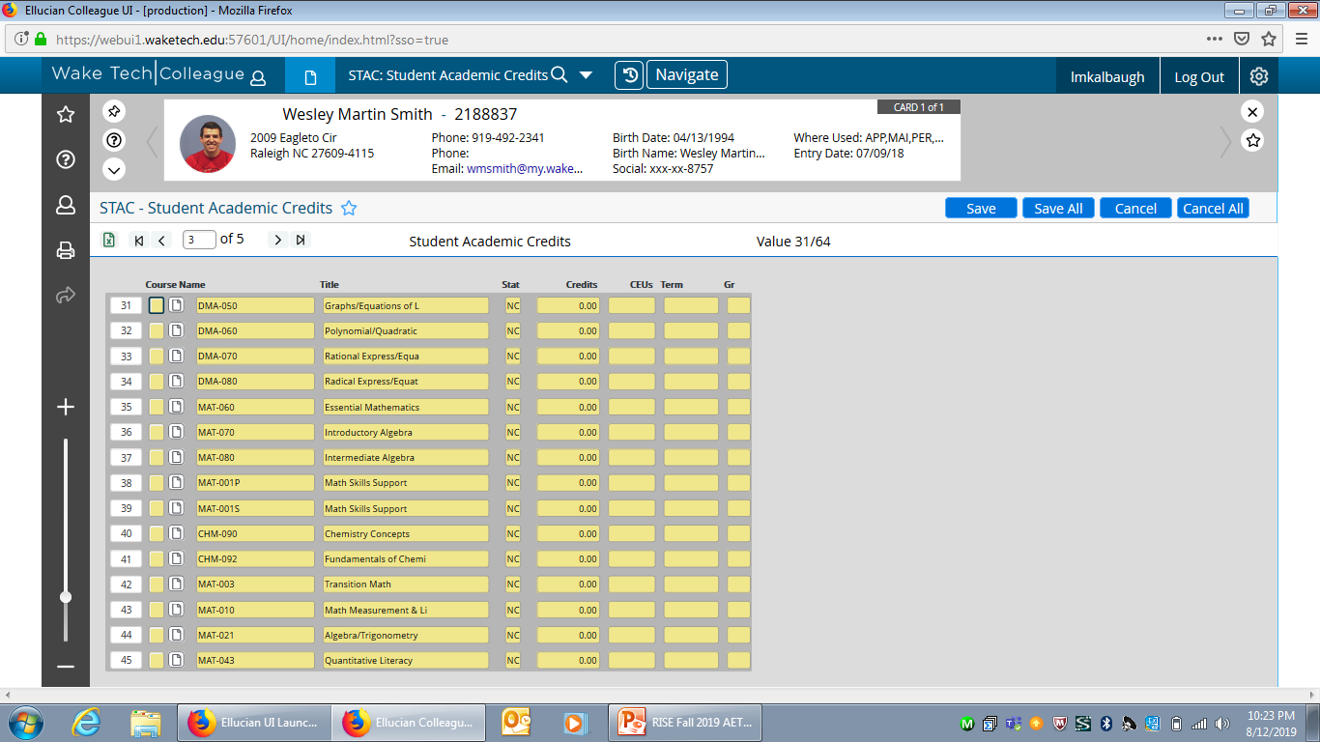
STAC SCREEN
Notes:
The STAC screen is a good tool to know what course credit the student has earned. Here you will see NC credit for developmental courses and grades for all courses taken.

Slide 16
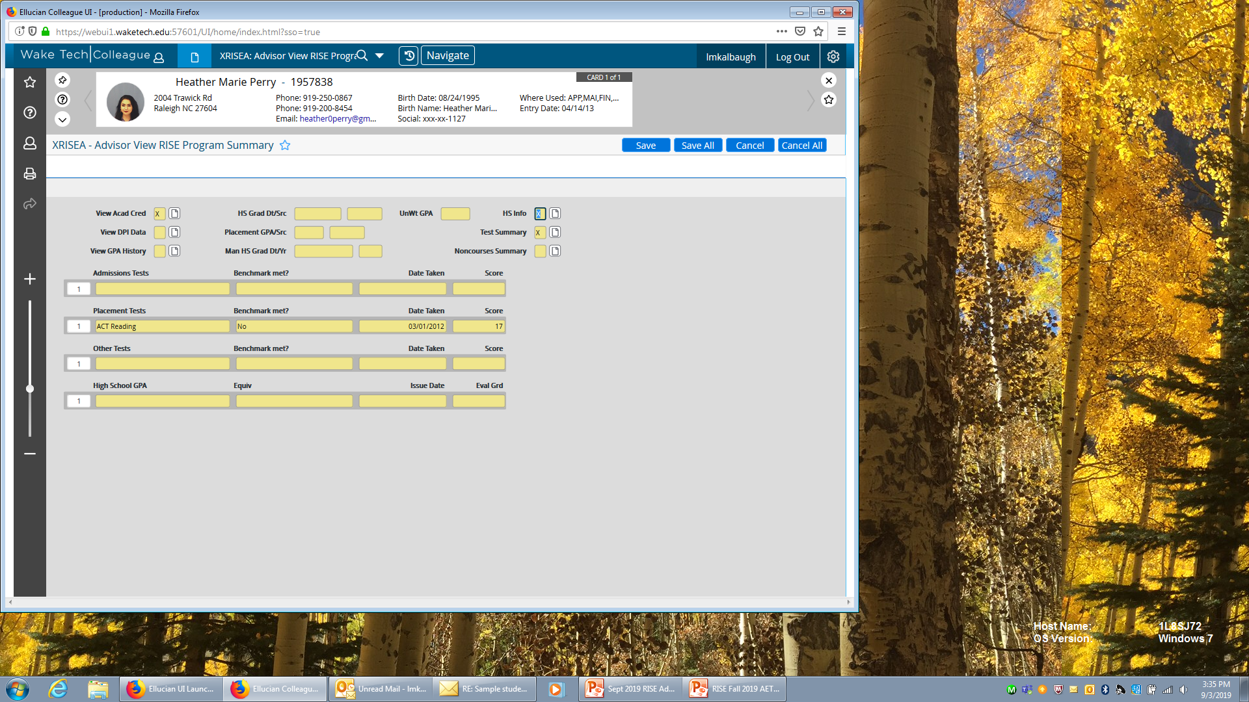
Judey
Notes:
Judey has some ACT scores but none that meet the benchmark. Drill down to see her HS GPA.

Slide 17
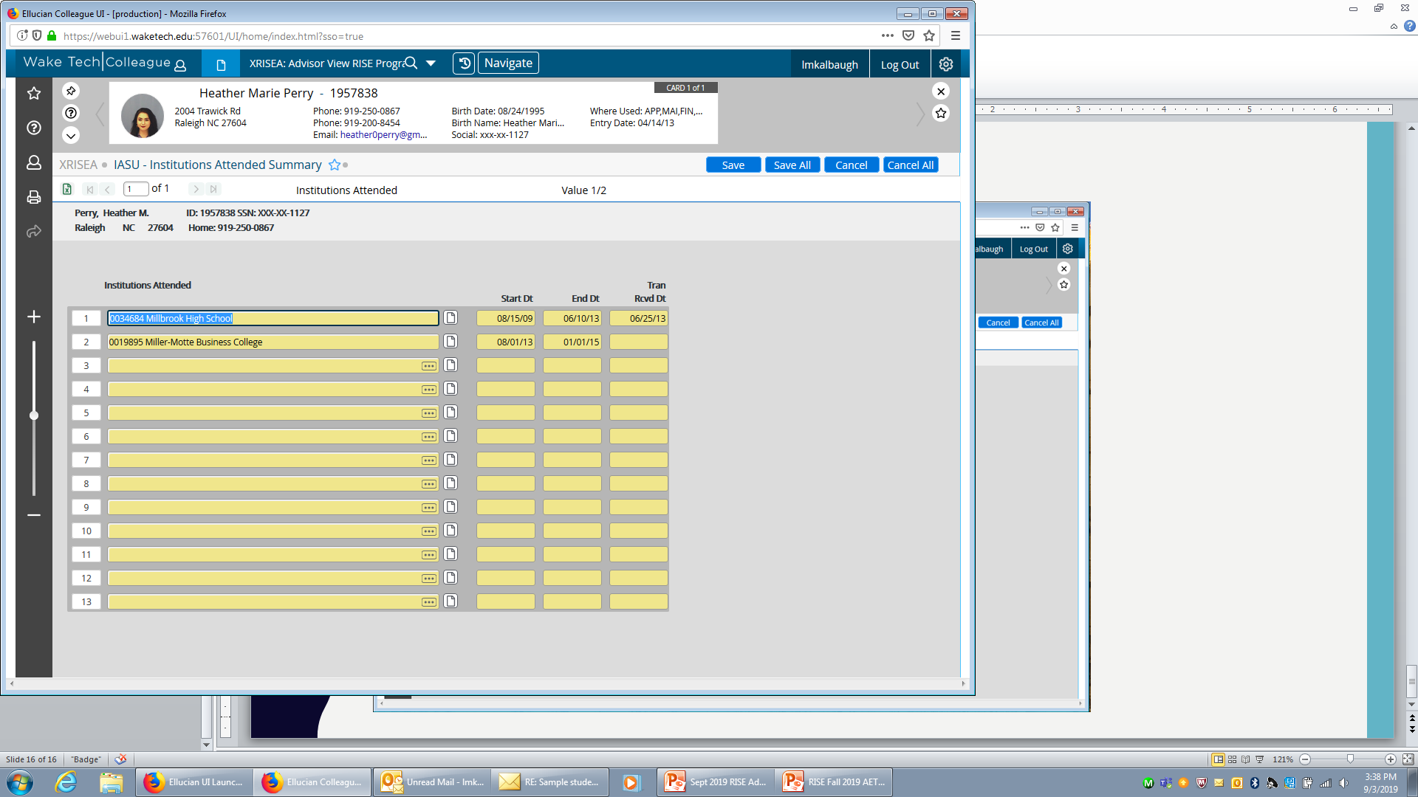
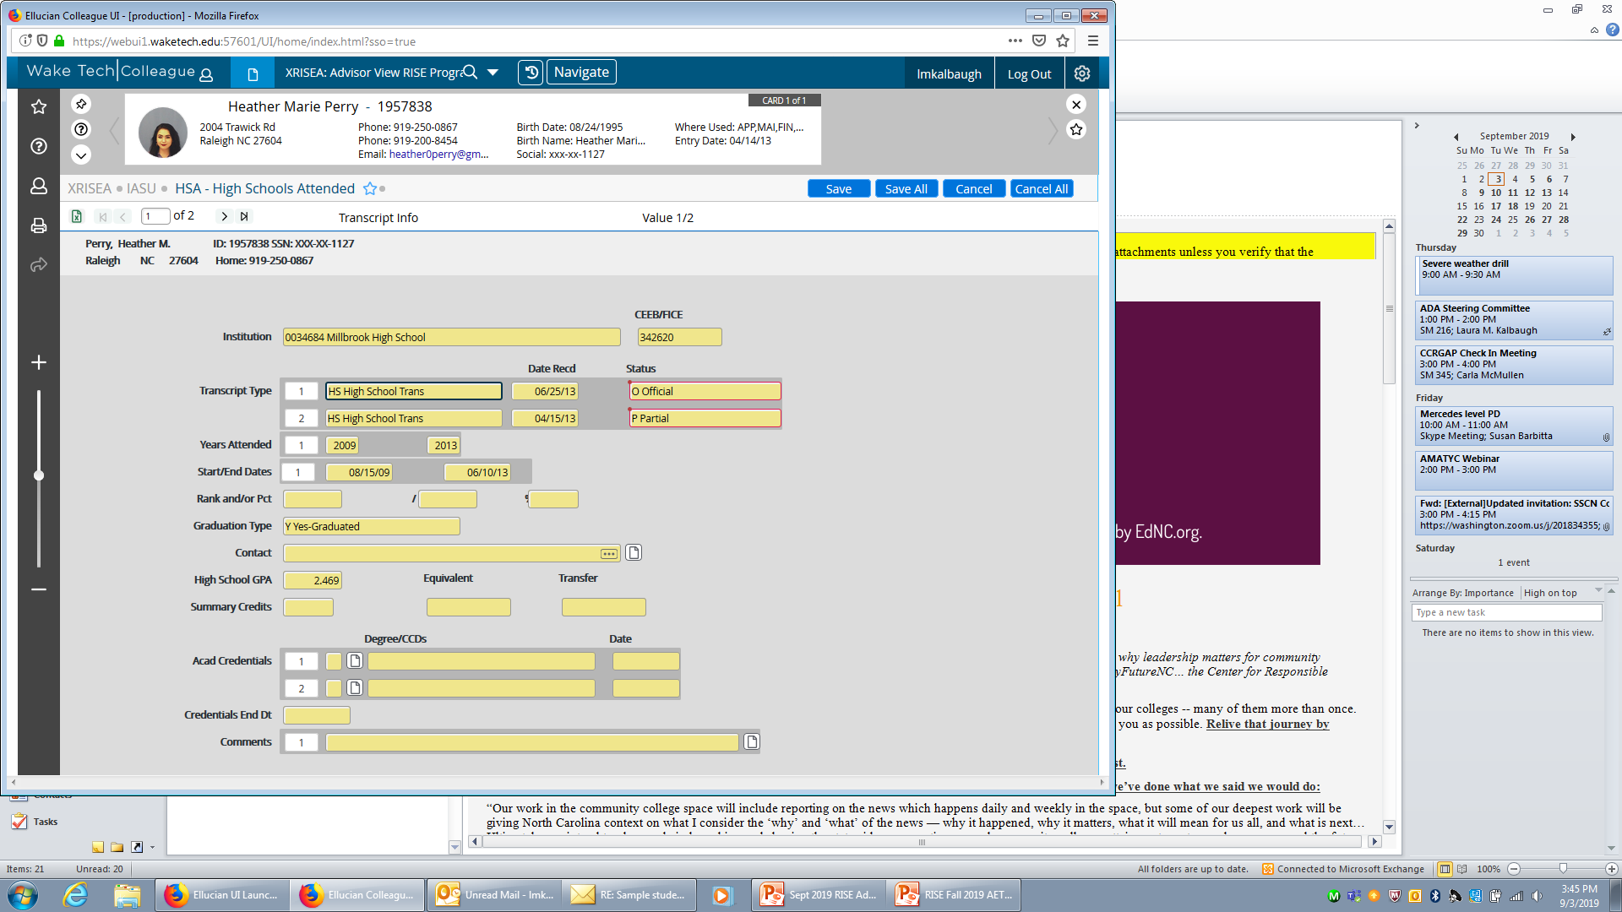
Judey
Notes:
Judey graduated from HS in 2013 so her GPA is within the 10 year window (in 2019). Her GPA is 2.4. What does this allow her to register for?

Slide 18
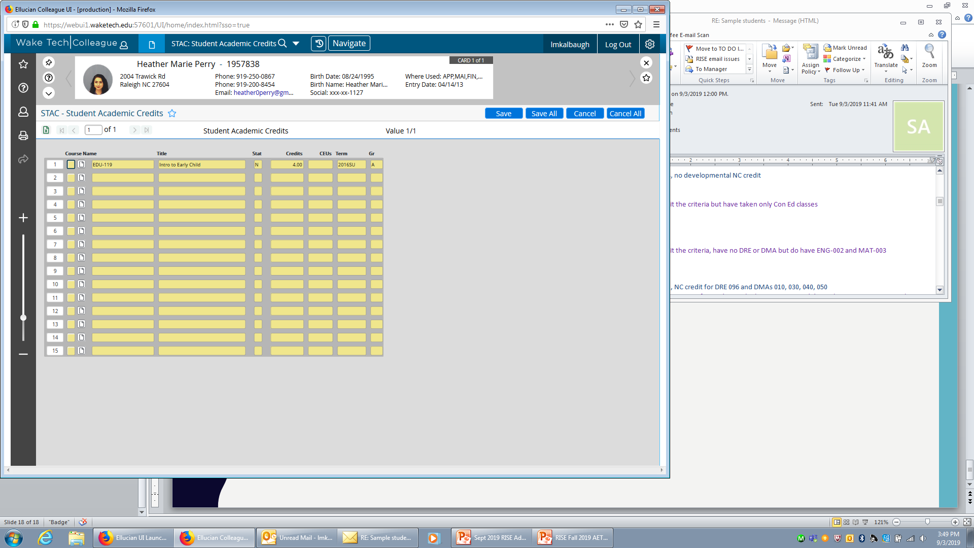
Judey
Notes:
Judey is a continuing student but must have stopped out. She has no DRE or DMA credit to place her higher.

Slide 19
Judey
ACT Scores from 2012 not high enough for placement
Graduated 2013
HS GPA 2.4
No other credit in STAC
Judey can take any gateway math or English with a corequisite because she has 2.4 GPA within 10 years of graduation

Slide 20
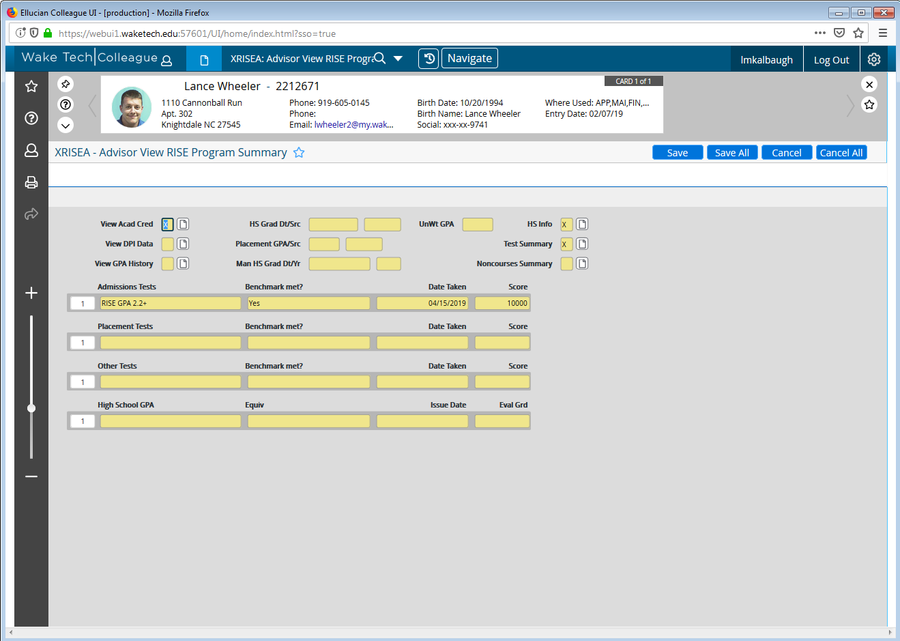
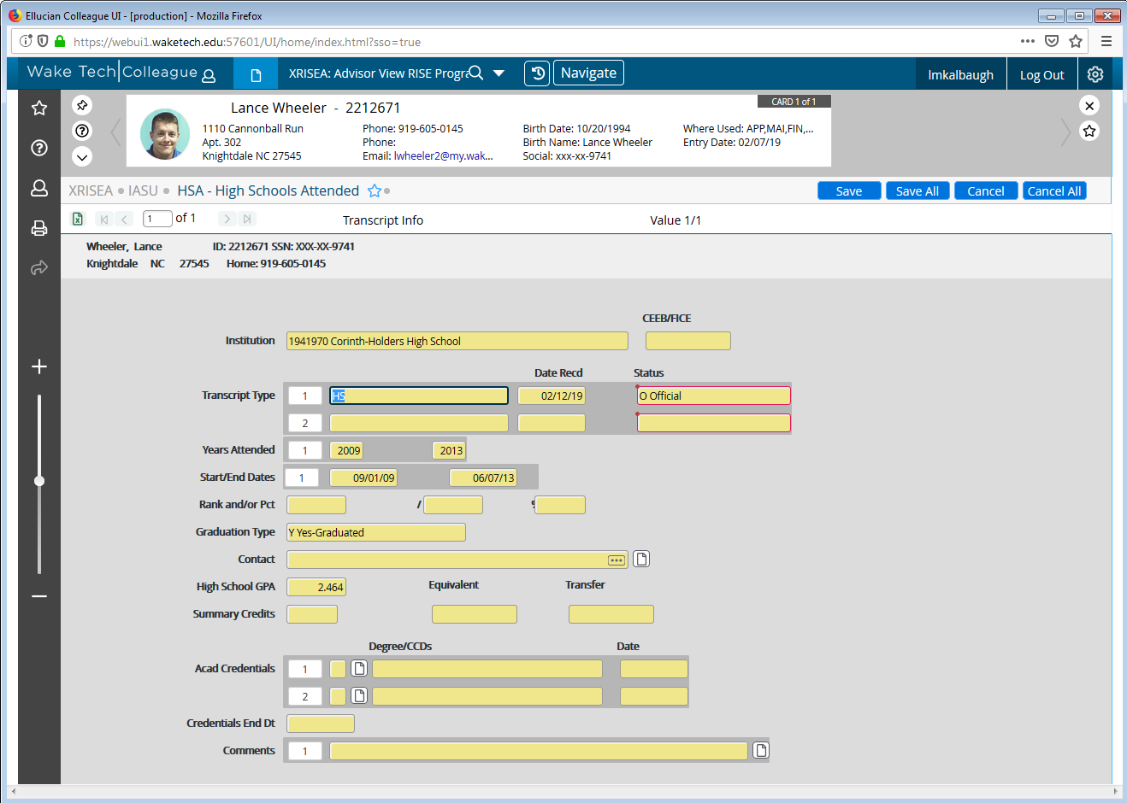
Tomas
Notes:
Tomas was admitted under RISE placement and the RISE GPA 2.2+ on his admission record (per system office direction from the patch). Drilling down we see that his HS GPA is 2.4 and he graduated in 2013.

Slide 21
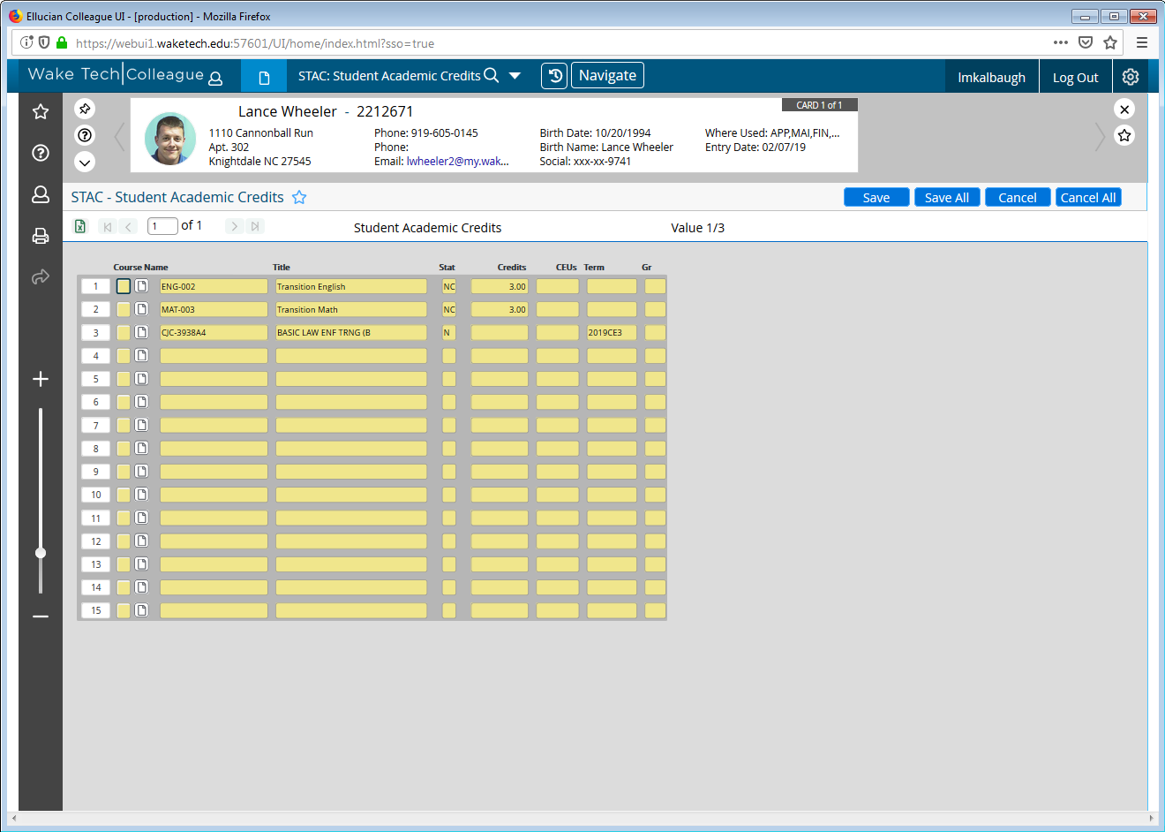
Tomas
Notes:
Because he was admitted under RISE, Tomas has NC credit for ENG 002 and MAT 003 – the transition courses.

Slide 22
Tomas
Graduated 2013
HS GPA 2.4
Given ENG 002 and MAT 003 NC credit upon admission
Tomas can take any gateway math or English course with a corequisite because he has a 2.4 GPA within 10 years of graduation

Slide 23
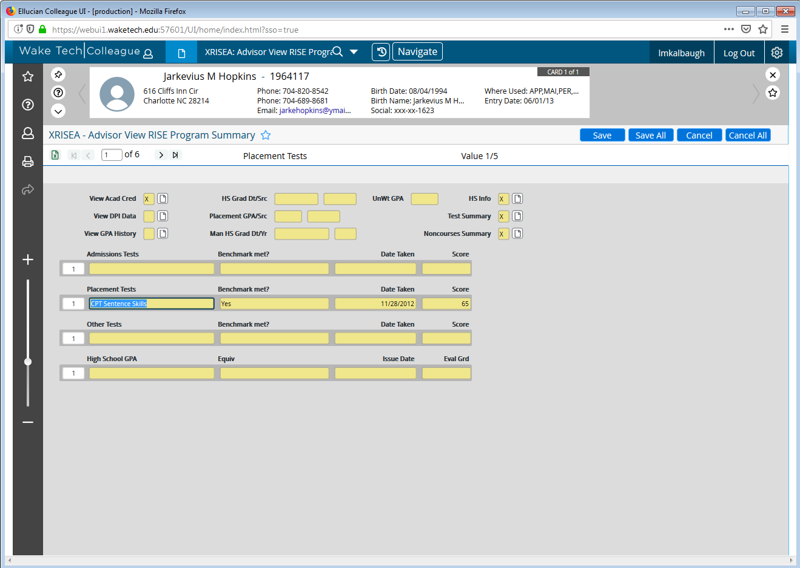
Mickey
Notes:
Mickey has an old test score that does seem to give her some credit. We better check her GPA.

Slide 24
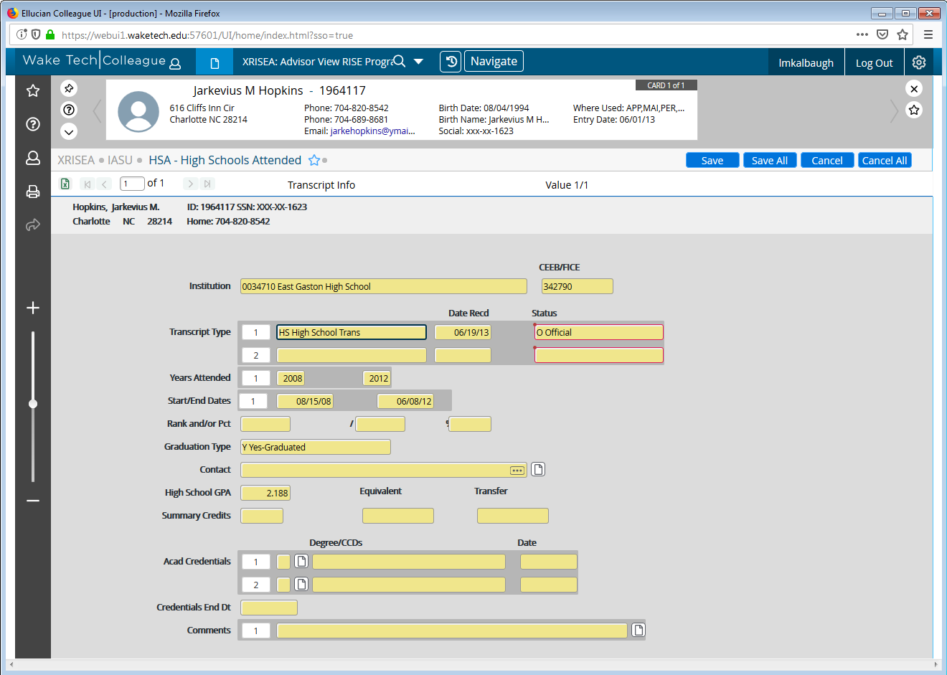
Mickey
Notes:
Her HS GPA is 2.1 from 2012. This is within the 10 year window (in 2019). What does Mickey’s GPA tell us?

Slide 25
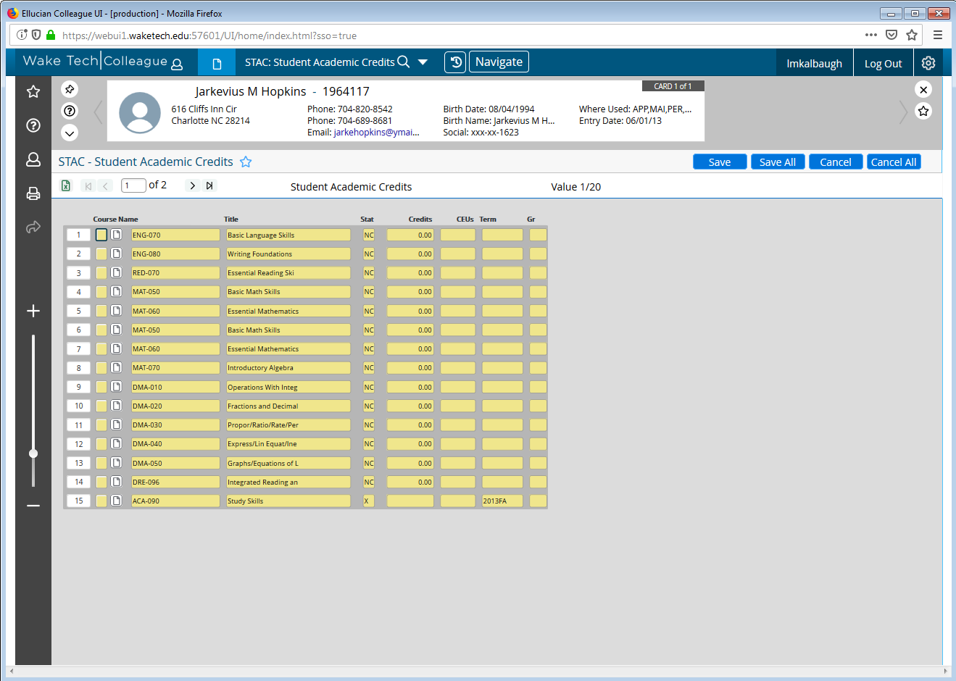
Mickey
Notes:
Mickey has gotten credit for DMA 010-050 and DRE 096 based on the tests she had previously completed. Does this place her higher than her GPA?

Slide 26
Mickey
This student has some test scores that we don’t have a quick crosswalk to use
Graduated in 2012 with a 2.1 HS GPA
STAC shows NC credit for DMA 010-050 and DRE 096
By GPA, Mickey must begin in the Transition course for both English and math
However, prior testing gave DMA 010-050 credit which translates to Tier 2 in math so Mickey can take any gateway math course (MAT 121 and MAT 171 require corequisites)

Slide 27
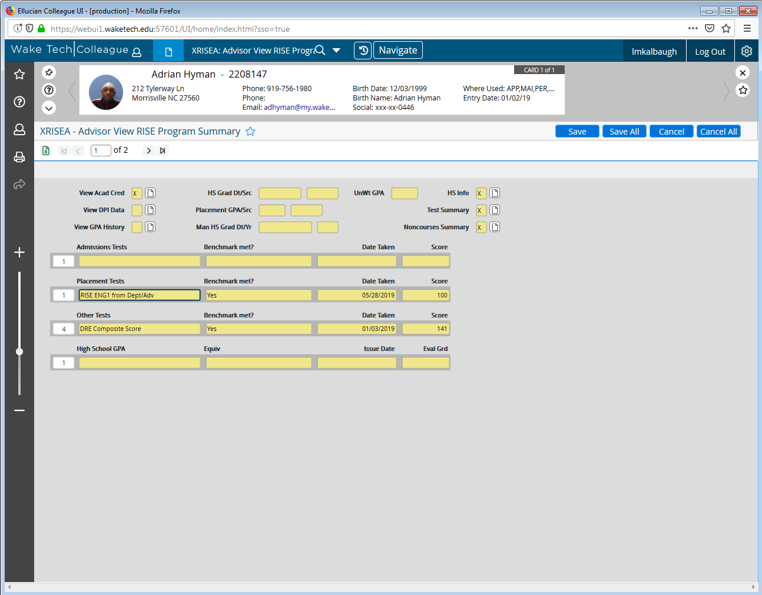
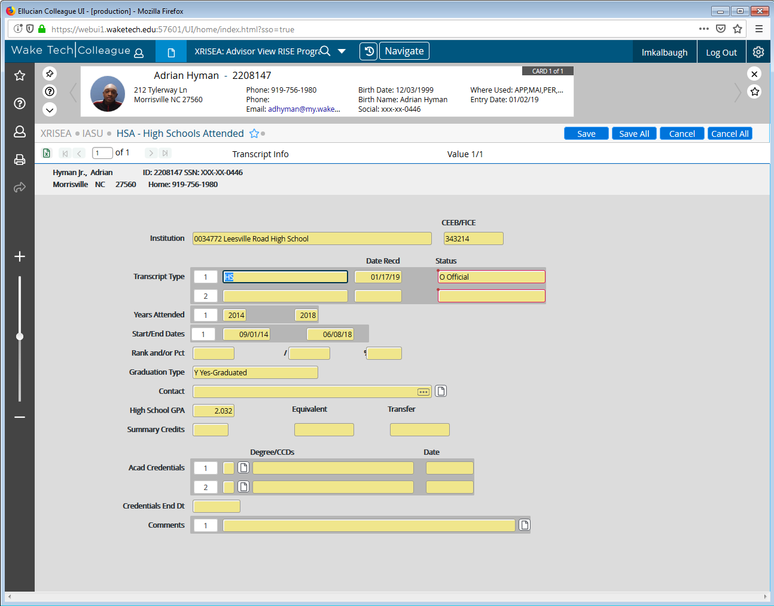
Greg
Notes:
Greg has a DRE Composite Score that gives him some credit. His HS GPA is 2.0 from 2018.

Slide 28
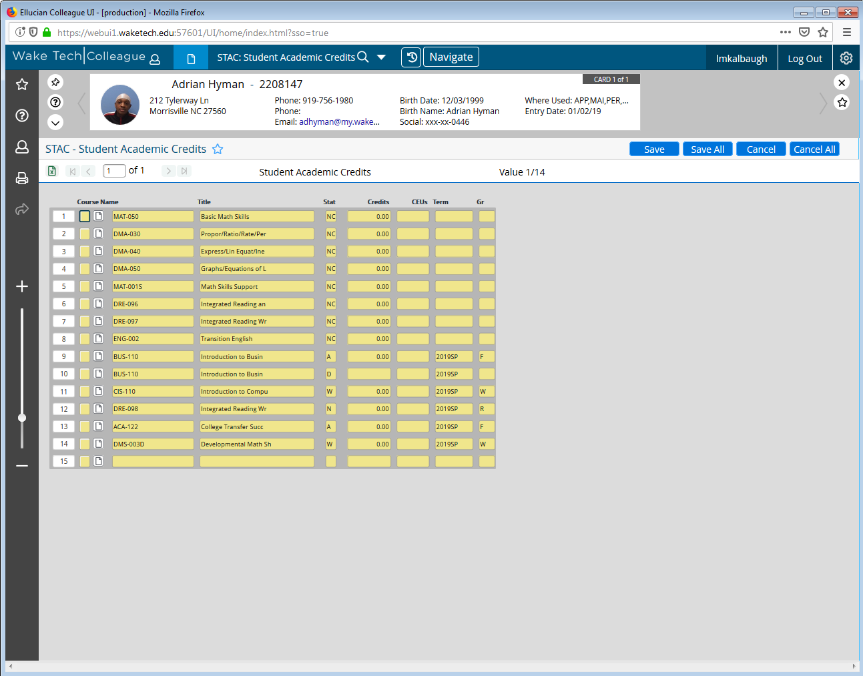
Greg
Notes:
Greg has gotten NC credit from the NC DAP for DRE 096 and DRE 097, which translate to what tier in ENG 002? He also has some DMA credit for DMA 030-050. What are his options for gateway English and math?

Slide 29
Greg
This student took the NC DAP because he didn’t meet multiple measures at the time of admission
He has GPA 2.0 which would place him in Transition math and English
He got credit through NC DAP for DRE 096, DRE 097, DMA 030, DMA 040, and DMA 050
When the college moved to RISE, the crosswalk gave him credit for ENG 002
Greg can take ENG 110 or ENG 111 with a corequisite
He needs to register for MAT 003 and begin in Tier 1

Slide 30
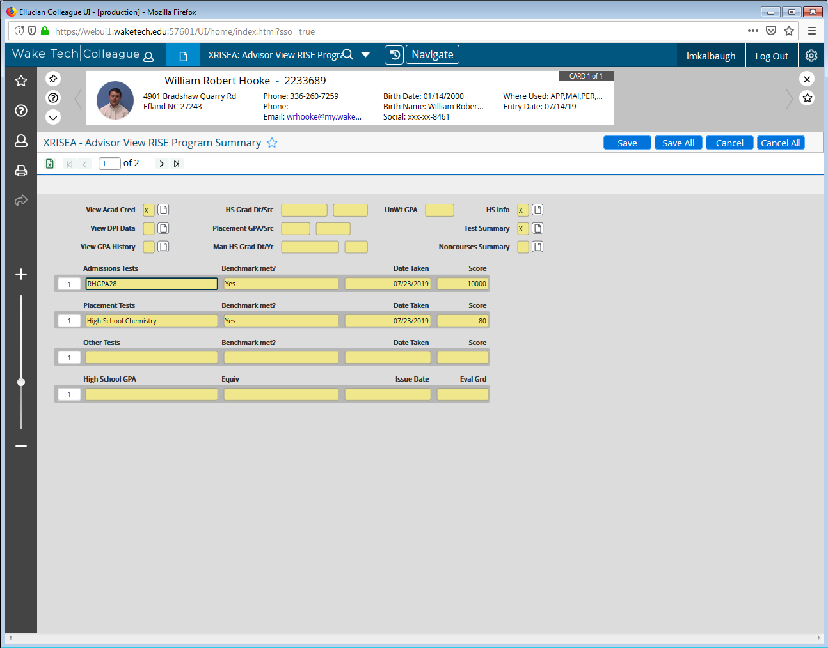
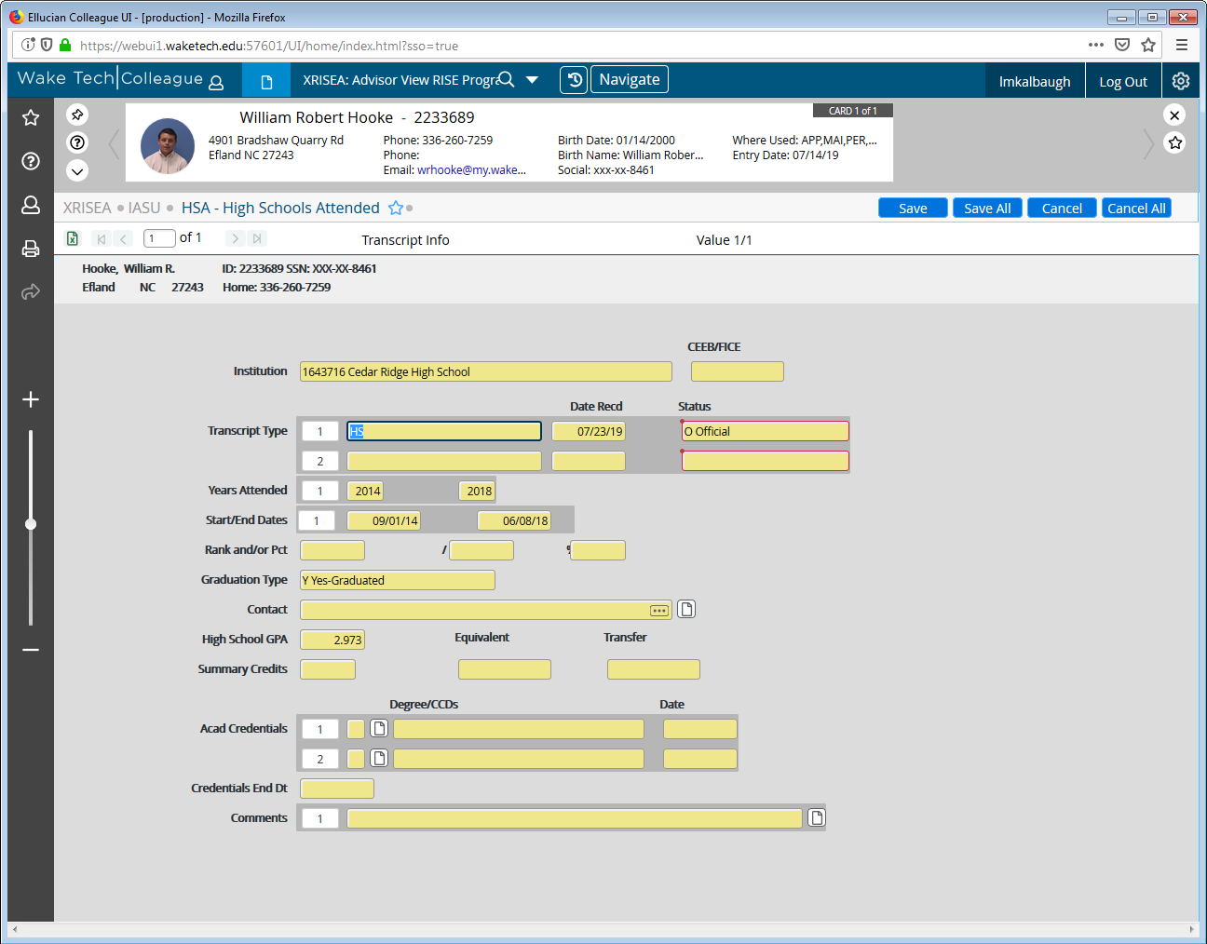
Sally
Notes:
Sally got RHGPA28 through admissions. When we drill down to her GPA we see it is 2.9 from 2018. What does this allow her to do?

Slide 31
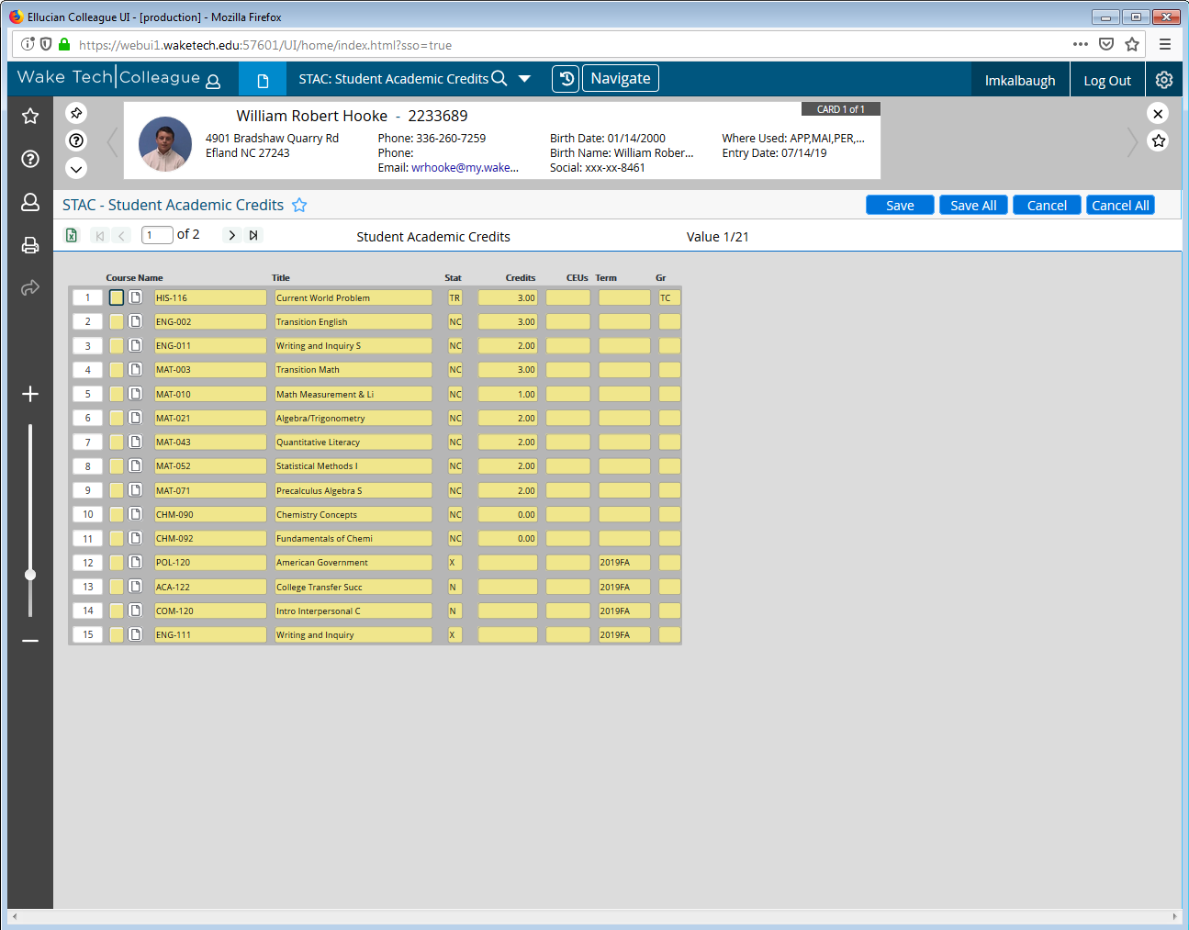
Sally
Notes:
We see RISE placement credit for transition and coreq courses in STAC. What gateway math and English can Sally take?

Slide 32
Sally
This student has a 2.9 GPA
Got RISE credit for RHGPA28 upon admission
NC credit for transition and corequisite courses in math and English
Sally may register for any gateway course without any corequisite courses required

Slide 33
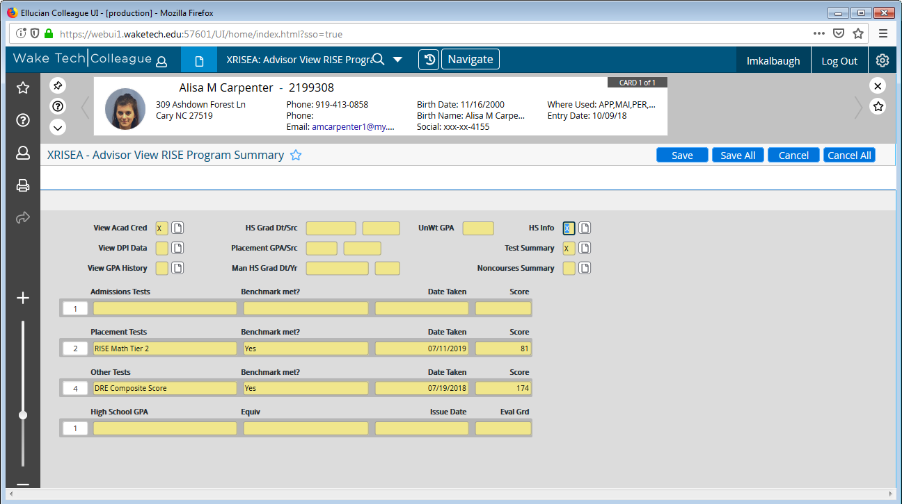
Kevin
Notes:
Kevin took the RISE Placement Test and had previously taken the NC DAP. He got placement on both.

Slide 34
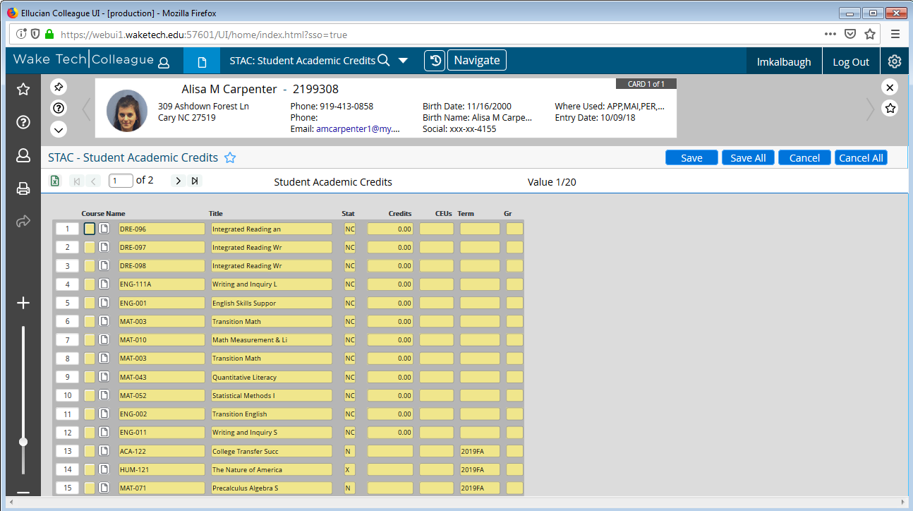
Kevin
Notes:
Kevin’s STAC screen shows DRE placement from the NC DAP and transition and coreq placement from the new RISE Placement Test. Based on the credit, what gateway courses can Kevin take with a coreq and what courses can he take without a coreq?

Slide 35
Kevin
Since Kevin came through adult high school and had no acceptable GPA, he took the placement test
Passed Math Tier 2 and previously got credit for DRE 098 on NC DAP
Credit in STAC for Transition courses, ENG 011, MAT 010, MAT 043, and MAT 052
Can take ENG 111 without a corequisite
Can take any math without a corequisite except MAT 121 and MAT 171 requires the corequisite courses

Slide 36
Wrapping up
When the college “flips the switch” to RISE placement new students will be given NC credit for RISE courses
Continuing students will have to be crosswalked into RISE courses
Will your college allow students to move into RISE courses based on DRE and DMA completion?
How will you communicate changes in requirements to students? Faculty?
Local requisites will need to be updated (CCL with updated state requisites will be released for Fall 2020)

Slide 37
Remember!
It won’t be perfect the first semester
Preparation will help with the transition
It will get better!
It is worth the work!

