Slide 1
Academic Advising
Professional Development: Part 3

Slide 2
Advising Resources
Look under My Courses:
Scroll down to Resources.
You will find the PCC Academic Advising Center & the PCC Transfer Center.
If you don’t have access, let me know.

Slide 3
Financial Aid

Slide 4
Financial Aid
When a student has any financial aid questions, refer them to:
Gretchen Steiger: Financial Aid Director
Do not try to answer financial aid questions. Always refer the student to Ms. Steiger.
Encourage students to prepare their financial aid applications early, for each academic year.

Slide 5
If a student wants to drop courses and they receive financial aid, suggest they go speak with someone in the financial aid office to see how it will affect them.

Slide 6
FERPA: Privacy
The Family Educational Rights and Privacy Act (FERPA) is a federal law that affords parents the right to have access to their children's education records, the right to seek to have the records amended, and the right to have some control over the disclosure of personally identifiable information from the education records.

Slide 7
What you can and can not discuss about a student’s education record is based FERPA law.
To see who you can and can not speak with, use the STRK mnemonic in Datatel.
When in doubt about FERPA regulations or if you have questions, please consult the Student Services staff.

Slide 8
Transcripts

Slide 9
College Transcripts
Have you taken college courses elsewhere?
If so, have you had an official transcript sent to the college registrar?
If not, tell them to contact that college/university and have an official copy sent to the PCC registrar.
For more details on how to do that, take the student to Student Services.

Slide 10
Ask the student if they have an unofficial copy of this transcript. It will give you an idea of what courses the student needs and does not need while you wait for the official transcript to arrive.
Avoid registering for those courses. Look at other courses that they need and have never taken anywhere.

Slide 11
If a course you would like to register the student for has a pre or co-requirement that is showing on the unofficial transcript, you cannot register the student based on this. That information is not official here at PCC till the registrar receives an official copy of the transcript.

Slide 12
The unofficial copy (photo copy or loose, unsealed original copy) does not take the place of an original, sealed copy. The student still needs to get an official copy sent to the registrar. Once the official copy arrives, the registrar will send you a transcript evaluation. Until you evaluate these courses, they will not be on the student’s PCC transcript and will not count towards graduation.
If a student hands you an official, sealed transcript, take it to the college registrar. Do not open it.

Slide 13
If transfer credits are showing on an official transcript from another institution, an official transcript from that particular institution needs to be sent to the PCC registrar as well to be officially added to the student’s PCC transcript and count towards graduation credits.
For example, my official ECU transcript shows I took ENG 1100 & 1200. The PCC registrar can give credit for those. If that same transcript shows ECU accepted some credits from my time at Craven CC, the PCC registrar needs an official transcript sent from Craven CC to give me credit for those courses here.

Slide 14
Transcript Evaluations
From time to time, the Registrar’s office will send you transcript evaluations that require your immediate attention.
These outside courses could possibly count toward graduation requirements or pre-reqs. in your program.
No student wants to waste time and money taking courses that they have already taken.
These courses do not show up on their transcript until we as advisors complete the evaluation.

Slide 15
In order to determine what the course being transferred translates to here may require some detective work on your part.
Of course, ACA 111 from Craven CC is ACA 111 at PCC. The registrar inputs these automatically.
But what is NUTR 1000 from ECU? It’s EDU 153.
Course descriptions are very helpful in determining what a course translates to here.

Slide 16
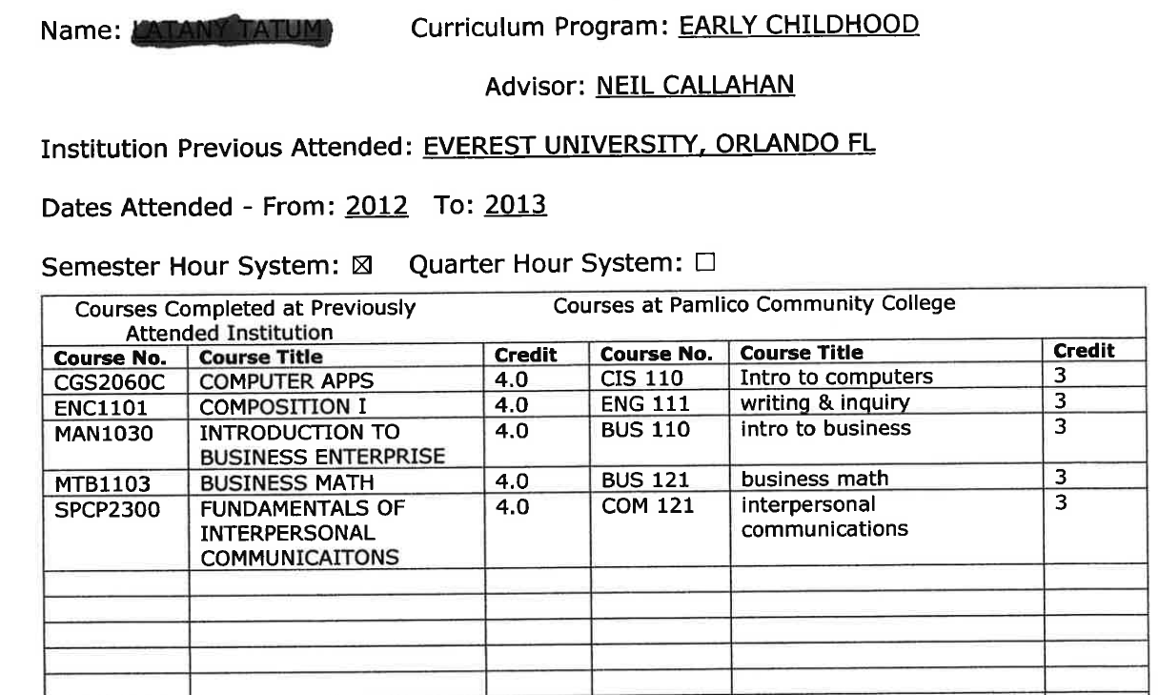

Slide 17
Be mindful of the number of credits the transferring course has.
If the course being transferred in is a 2 credit course, you cannot translate it to a 3 credit course equivalent at PCC.
If you require further help in determining what a course translates into, you can touch base with the subject matter expert.
If you cannot contact the subject matter expert, contact Neil Callahan for assistance.

Slide 18
Review Transcripts (Give Them Credit)
As you advise, or prepare to advise, your students, be sure to look over their transcript in Datatel Colleague using the EVAL function.
Once you have printed a copy of the student’s transcript information using the EVAL function, look for the section at the end of the document called “Other Courses.”

Slide 19
In this section, you may find courses the student has taken here or elsewhere that have not been filtered into the program requirement sections on the EVAL transcript.
Examine these courses carefully because you may find a course that can be used as a program requirement.
To know for sure, always refer to your Curriculum Standard, located on the NCCCS website.

Slide 20
If you have further questions about whether the course can be used as a program requirement, consult the college registrar.

Slide 21
Program Certificate, Diploma, and Degree Completion

Slide 22
Program Certificate, Diploma, and Degree Completion
As students move through their program of study, be aware of completion milestones.
As students complete program certificates and diplomas on their way towards completing their two-year degree, have them apply to receive these as they earn them.
This is better than letting them wait till the very end to apply for their two-year degree, diploma, and all earned certificates.

Slide 23
Why?
They may not complete the two-year degree. If not, they may have enough credits for a diploma or certificate.
It shows PCC has “completers”. The more “completers” PCC has, the better we look as an institution.

Slide 24
When you get a new student, be sure to look over their listed of completed courses on the STAC and EVAL screen in Datatel.
They may have completed courses at PCC in the past or have transfer credit for courses from other institutions.
Sometimes these random course credits on their transcript that may add-up to something (certificate, diploma, etc.) in another program.
Make sure they apply for it if they have not already.

Slide 25
The Process:
Have the student fill out the “Application for Graduation”. Look for it in Student Services or on the PCC Academic Advising Center.
Make sure they note which certificates, diplomas, and degrees they are applying for.
Turn it in to Student Services.

Slide 26
Understand Your Program of Study (POS)

Slide 27
Understand Your Program of Study (POS)
As a subject matter expert (SME), you need to be well versed in your POS.
POS: Program of Study
Your POS is based on your Curriculum Standard.
The Curriculum Standard is developed on the state-level.
Your knowledge of your POS can help students progress quicker towards graduation.

Slide 28
For questions about your Curriculum Standard, contact your state-level subject matter specialist.
If you are not sure who this person is, please talk with your supervisor to help you find this information.

Slide 29
POS Basics
Your POS has a minimum and maximum number of credits it has to be.
Minimum: 64 semester credit hours
Maximum: 76 semester credit hours
Since the implementation of Completion by Design at PCC, your POS semester credit hours necessary to obtain a two-year degree should be close to 64 semester credit hours.

Slide 30
The POS/Curriculum Standard is made up of several categories:
General education requirements
Major hours/Requirements
Aka the “Core”
Other required/major hours
See your POS/Curriculum Standard for more details.

Slide 31
Within the POS/Curriculum Standard, certain course requirements are set by the state:
General education requirements
There may be some leeway as far as course choices.
Major hours/Requirements
Aka the “Core”.
These can not be changed or substituted.
See your POS/Curriculum Standard
for more details.

Slide 32
The rest of the courses are chosen by you to make up the required 64-76 semester credit hours needed for a two year degree.
These courses are placed under the “Other required/major hours” category.
These courses have to be chosen from state approved prefixes.
These courses can be substituted if necessary, following the correct guidelines.
See your POS/Curriculum Standard
for more details.

Slide 33
Changes To The POS
Changes to your POS can only be made once during the course of the school year:
These changes will go into effect the following fall semester.
The process:
Step one: Present your POS changes to your advisory board for approval.
Step two: Submit your POS changes to the Instructional Services Committee for approval.

Slide 34
Step three: Submit your approved POS changes to the college registrar.
Note: Remember to start this process early enough to get all the approvals you need.
The Instructional Services Committee only meets once a month (maybe less now).
For more details, speak with your supervisor.
If you have additional questions about the process, see registrar, LaTanya Bryant.

Slide 35
Questions?

