Slide 1
Mnemonics for Advisors
PCC Academic Advising Training Series

Slide 2
Introduction
The following slides are the most commonly used mnemonics for advisors:
All advisors have access to these pages within Colleague.
None of “OK” and “Finish” clicks were added to this set of slides.
If you would like to schedule time with Tammy for one on one help please do not hesitate to ask.

Slide 3
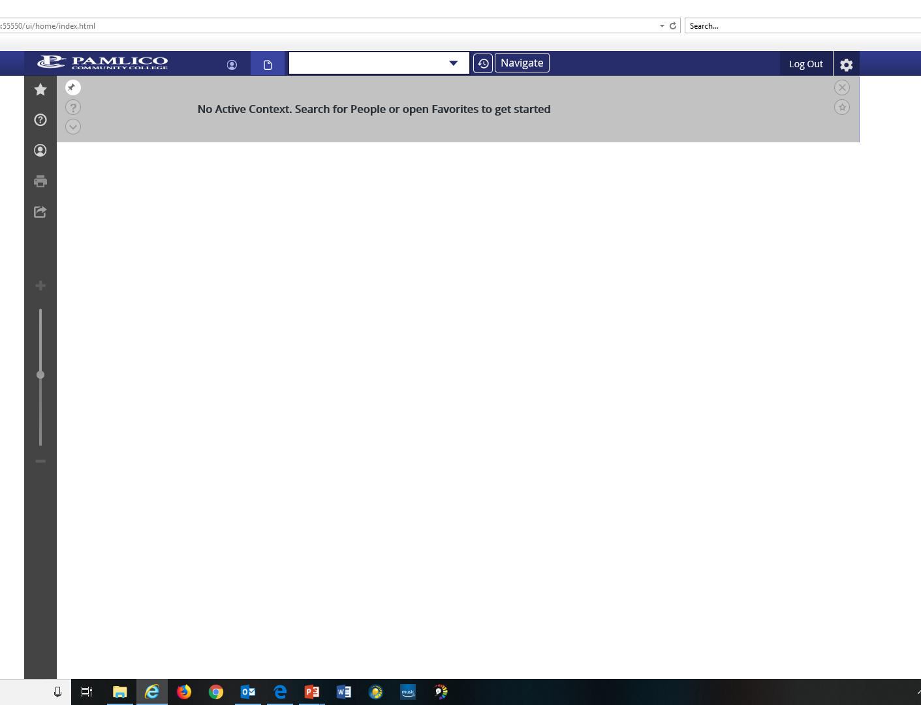
Type in your mnemonic of choice. For Example: STAC

Slide 4
Once you have typed in a few mnemonics, they will be saved in your search history.

Slide 5
Common Mnemonics
Mnemonic | Description
STAC | Student Academic Credits
EVAL | Evaluate Student Program
TSUM | Test Summary
SMIN | Section Meeting Inquiry
RGAM | Registration Activity Monitor
RSTR | Academic Roster Inquiry
STSC | Student Schedule
RGN | Registration
PSPR | Proposed Student Program
STRK | Student FERPA Information
XRISE | RISE Placement Information

Slide 6
Looking Up The Last Thing Accessed
To look up the last student or course accessed, type in:
@

Slide 7
STAC: Student Academic Credits

Slide 8
STAC: Student Academic Credits
STAC stands for:
Student Academic Credits
This is the page to use when looking to see which classes have been taken, along with grades received.

Slide 9
Enter the Students Name or Student ID here
Examples:
0220000
Smith, Joe
Joe Smith
Smith, J

Slide 10
Choose the student record you want to look at. Click on it
Click here if you need to see more pages.

Slide 11
Click to see the other pages
Student info
What she has taken
Developmental courses are listed first

Slide 12
STATUS Codes
N-New
A-Add
D-Dropped
W-Withdrawn
X-Deleted
NC-Noncourse Equivalency
NP-Non Payment
TR-Transfer Credit

Slide 13
EVAL: Evaluate Student Program

Slide 14
EVAL: Evaluate Student Program
EVAL stands for:
Evaluate Student Program.
You go here to find out:
What courses they have taken.
What course requirements are left.
Who the listed academic advisor is.
College GPA.

Slide 15
Enter the Students Name, Social Security Number or Student ID here

Slide 16
Choose the student record you want to look at. Double click.

Slide 17
Choose the Active Academic Program. Check the box or enter the # in the white box at the bottom and hit enter.

Slide 18
Do nothing but click SAVE ALL on this page.

Slide 19
Page 1 of 2
These sections give you the requirements for graduation and what is needed in order to graduate.
Click here to print. See next slide

Slide 20
Use these settings. They work best.

Slide 21
Click it.

Slide 22
Click it.

Slide 23
Click it to print.

Slide 24
TSUM-Test Summary Page

Slide 25
TSUM-Test Summary Page
TSUM stands for:
Test Summary Page
You go here to find:
Placement test scores and RISE information
Multiple measures

Slide 27
Placement test score: Shows English
Click inside and use the down arrow to see if more pages of info are available
Shows math.

Slide 28
TSUM screen with RISE info

Slide 29
RGN-Registration Screen

Slide 30
RGN-Registration Screen
RGN stands for:
Registration
This is where you register your students.

Slide 31
Be sure you are in the current term. If blank like this, type 2019SP ACA 122
Here, you will see if she is pre-registered or registered, plus the number of credits hours she is taking

Slide 32
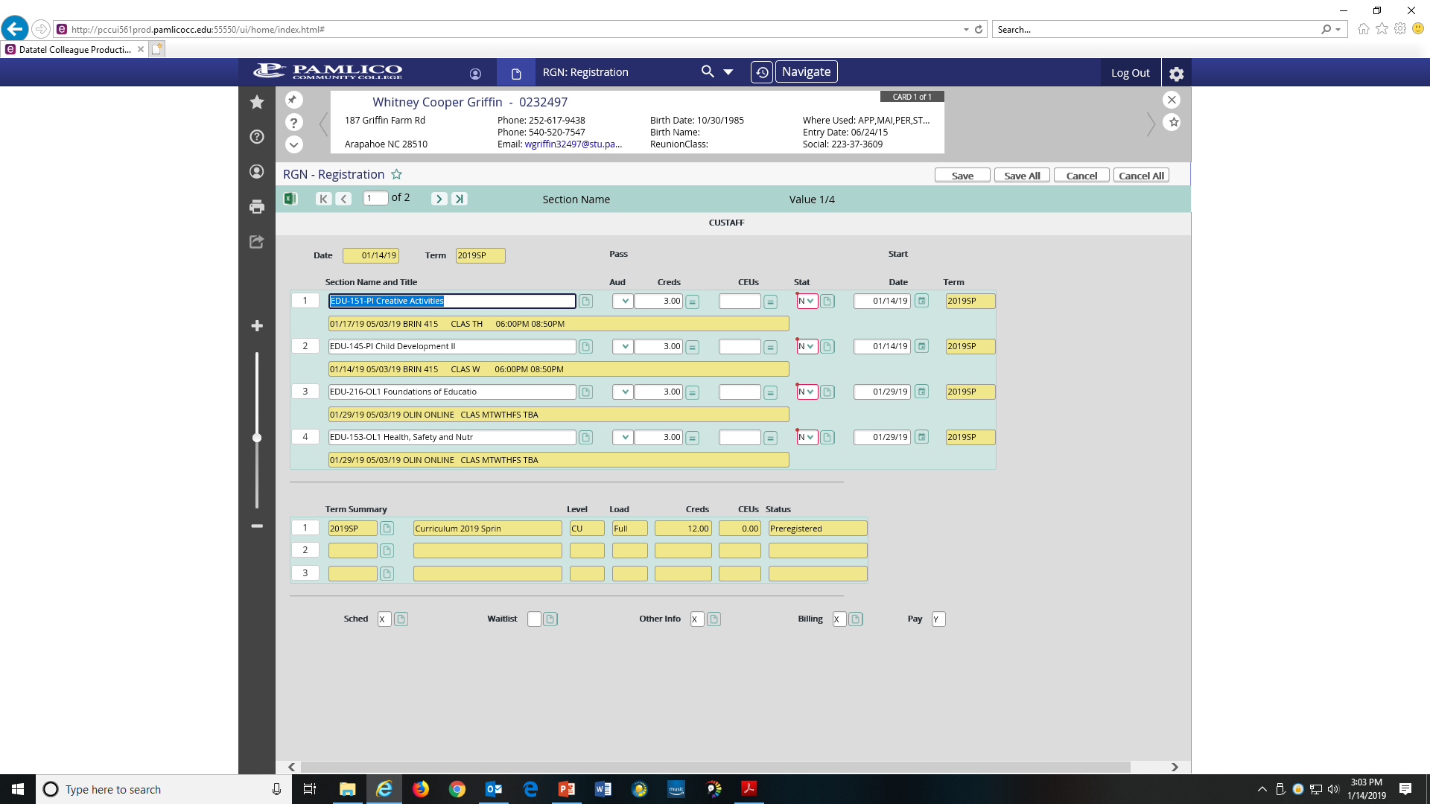
Type in: EDU 151 PI
Click inside one and use the down arrow to get to a new page

Slide 33
RSTR-Academic Roster Inquiry

Slide 34
RSTR-Academic Roster Inquiry
RSTR stands for:
Academic Roster Inquiry
This page can be used to see the list or roster of students in a particular class section.

Slide 35
Type in the course: CIS 110

Slide 36
Pick the section you want. Click on it.

Slide 37
Drill down to learn more about that student. Click it.

Slide 38
STSC-Student Schedule

Slide 39
STSC-Student Schedule
STSC stands for:
Student Schedule
You use this to see what a particular student’s course schedule is.

Slide 40
Type in student

Slide 41
Type in term

Slide 42
His schedule

Slide 43
SMIN-Section Meeting Inquiry

Slide 44
SMIN-Section Meeting Inquiry
SMIN stands for:
Section Meeting Inquiry
This page can be used to see the list or roster of students in a particular class section.

Slide 45
Type in the course: CIS 110

Slide 46
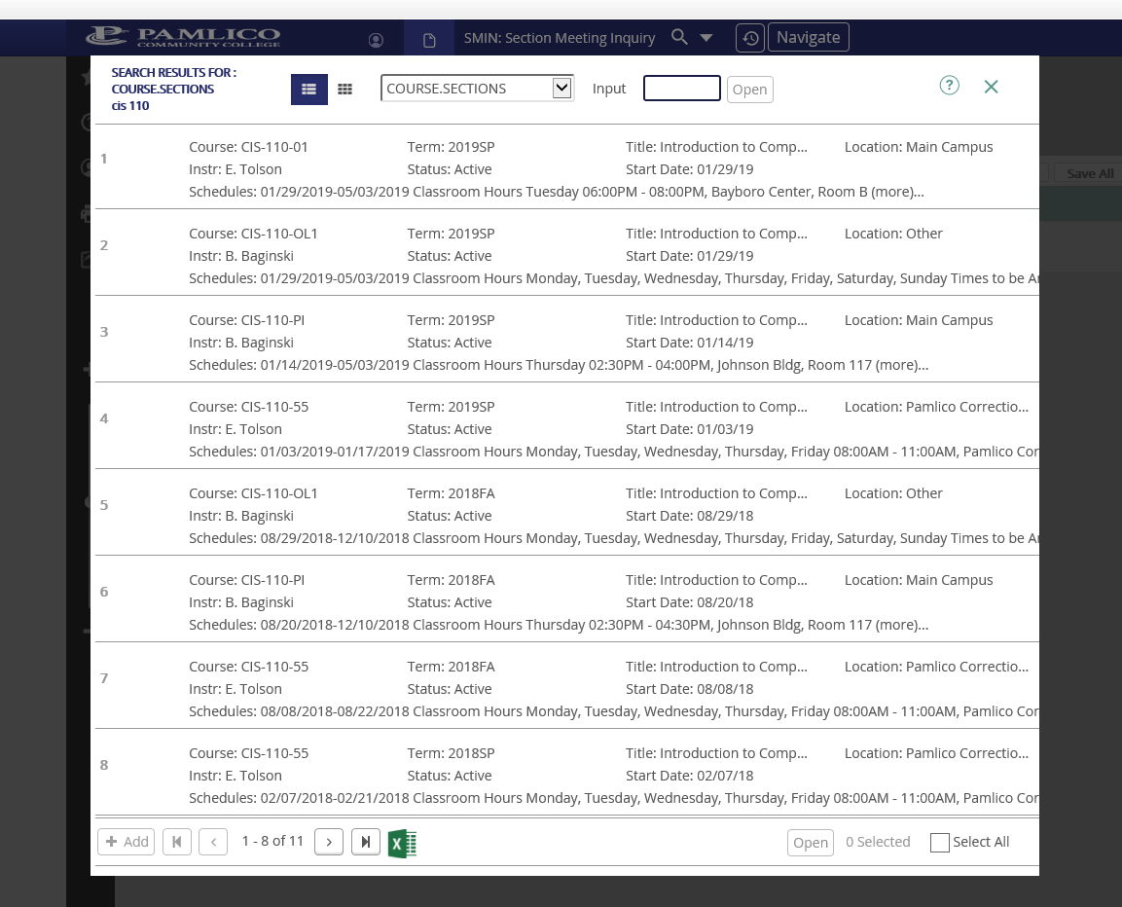
Pick the section you want. Click it.

Slide 47
22 students. Click the box next to the number to drill down and see who they are.

Slide 49
STRK-Student FERPA Information

Slide 50
STRK-Student FERPA Information
STRK stands for:
Student FERPA Information
Use this mnemonic to determine if a student has a FERPA release form on file.
This helps you know who you can and can not speak to about the student (college info).
You can only speak to the people the student has listed.
No one listed: You can only speak to the student.

Slide 51
Type in student

Slide 52
No form. Only speak to Farrell

Slide 53
Click here to see the form.
Mr. Watson has a form. Click on it to see who you can talk to about him.

Slide 54
I can talk to his mom and dad.

Slide 55
PSPR-Proposed Student Program

Slide 56
PSPR-Proposed Student Program
PSPR stands for:
Proposed Student Program
This is where you can get a look at the student’s transcript in their current Program of Study.
This page will also allow you to perform an evaluation on your student in any Program of Study at PCC (even if the student is not currently registered for that program).

Slide 57
Type in student.

Slide 58
Select student. Enter.

Slide 59
Let’s see what she would look like as a A55220CT. Hit Enter.
Ms. Holley is currently an A10100 student

Slide 60
Select catalog of choice. In my example, 2018. Hit enter.

Slide 61
See the POS we are checking out.
Drill down. Click on it

Slide 62
Click Save All

Slide 63
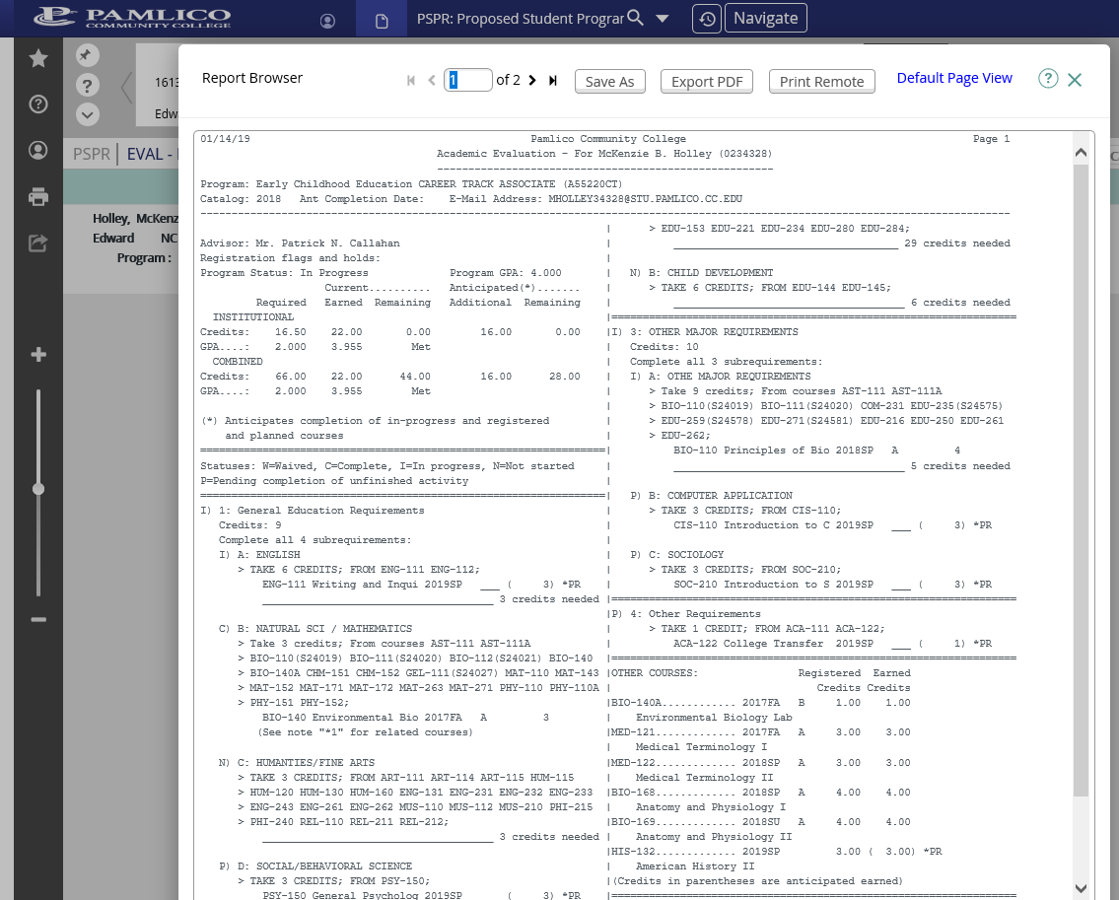
Click to get a printable copy

Slide 64
I use these settings
Select Letter
Click it.

Slide 65
Click Download.

Slide 66
Click open.

Slide 67
Click print.

Slide 68
XRISE: RISE Placement Information

Slide 69
XRISE: RISE Placement Information
XRISE stands for:
RISE Placement Information
You go here to find:
The students high school GPA as it applies to math and English course placement.

Slide 70
RISE English: GPA Scores
HS GPA 2.8 or above | HS GPA 2.2-2.799 | HS GPA below 2.2
Gateway English course: ENG 111 | Gateway English course (ENG 111) with ENG 011 co-req. | BSP 4002 (Tier 1 ) Unit 1-6 for: ENG 111 with co-requisite course
 |  | BSP 4002 (Tier 1 & 2) Unit 1-10 for: ENG 111 with no co-requisite course

Slide 71
RISE Math: GPA Scores
HS GPA 2.8 or above | HS GPA 2.2-2.799 | HS GPA below 2.2
Gateway math course: MAT 110, 143, 152 or 171 | Gateway math course with corresponding co-requisite course: MAT 010, 043, 052, or 071 | BSP 4003 (Tier 1) Unit 1-8 for: MAT 110 with no co-requisite course MAT 143 or 152 with corresponding co-requisite course if BSP 4002 (T1 & T2) completed or bypassed.
 |  | BSP 4003 (Tier 1 & 2) Unit 1-12 for: MAT 143 or 152 with no co-requisite course if BSP 4002 (T1 & T2) completed or bypassed. MAT 171 with corresponding co-requisite course.
 |  | BSP 4003 (Tier 1-3) Unit 1-17 for: MAT 171 with no co-requisite course.

Slide 72
Pick a person to look up and hit OK.

Slide 73
Double click

Slide 74
Her GPA is 2.286. She can take any math or English with the co-requisite course

Slide 75
Drill down to see what is in the STAC window related to RISE.

Slide 76
Her GPA is 2.915. She can take any math or English without the co-requisite course

Slide 77
See the credit for ENG 002 and 011. She can take ENG 111 straight up.
See the credit for MAT 003 and 010, 021, 043, 052, & 071. She can take any math course straight up.

Slide 78
Questions? Contact:
The College Registrar in Student Services
Or
Neil Callahan
ncallahan@pamlicocc.edu
Ext. 3042

