Slide 1
Student Advising
Advising Professional Development

Slide 2
PCC Advising Moodle Site

Slide 3
Getting Started

Slide 4
Student Advising Guidelines
First semester academic performance:
Performance during the first semester is the best predictor of retention.
Knowing this, we should place students in the proper courses in order to maximize their potential for success.

Slide 5
Evidence shows that effective academic advising and uncomplicated registration procedures can be major factors in student retention.
Through positive interaction with students, college bonds and connections can be formed, making both advising and registration core processes in retention.

Slide 6
Getting Started
Upon meeting a new student for the first time, introduce yourself and your program. Engage in conversation; learn as much as you can about them as a person.
Talk to the student about why they are here at PCC.
Ask about the student’s educational and career goals and help him/her develop an educational plan to reach those goals.

Slide 7
Ask questions such as: Are you planning to transfer to a four-year college? Are you planning to go to work after you receive your two-year degree? If so, what are you planning to do?
Based on the conversation, you need to determine if they in the right place. If they are interested in another program, introduce them to the proper subject matter expert.

Slide 8
As you get to know the student, be sure to start a file on them for your records.
Collect basic information as listed at the top of the FOS Advising Checklist.
Pay careful attention to contact numbers. This makes getting up with the student in the future much easier.
Give the student your contact information as well.

Slide 9
Before you go much further, ask the student if they have taken care of the following things:
Have you filled out a PCC application? If not, proved them with one and have the student fill it out. Return the application to Student Services in order to have their information input into our system.
Have you filled out financial aid paperwork, if applicable? If not, have the student go to Student Services and speak with someone in the Financial Aid Department.

Slide 10
Check their math and English placement test scores. If they have not taken these tests, have them go to Student Services and ask to see the college counselor.
Has the student ever taken online courses at PCC? If not, administer the Online Readiness Assessment during the advising process to determine if the student is prepared for the level of commitment needed to be successful in online course work. For more information about the Online Readiness Assessment, go the PCC Advising Moodle site.

Slide 11
Have you taken college courses elsewhere? If so, have you had an official transcript sent to the college registrar?
Ask the student if they have an unofficial copy of this transcript. It will give you an idea of what courses the student needs and does not need while you wait for the official transcript to arrive.

Slide 12
Avoid registering for those courses. Look at other courses that they need and have never taken anywhere.
If a course you would like to register the student for has a pre or co-requirement that is showing on the unofficial transcript, you cannot register the student based on this. That information is not official here at PCC till the registrar receives an official copy of the transcript.

Slide 13
The unofficial copy (photo copy or loose, unsealed original copy) does not take the place of an original, sealed copy. The student still needs to get an official copy sent to the registrar. Once the official copy arrives, the registrar will send you a transcript evaluation. Until you evaluate these courses, they will not be on the student’s PCC transcript and will not count towards graduation.

Slide 14
If transfer credits are showing on an official transcript from another institution, an official transcript from that particular institution needs to be sent to the PCC registrar as well to be officially added to the student’s PCC transcript and count towards graduation credits.
For example, my official ECU transcript shows I took ENG 1100 & 1200. The PCC registrar can give credit for those. If that same transcript shows ECU accepted some credits from my time at Craven CC, the PCC registrar needs an official transcript sent from Craven CC to give me credit for those courses here.

Slide 15
PCC’s QEP: Focus On Success (FOS)
Identify if the student is a first year student (FOS), if they have not been identified already by Student Services.
The Focus on Success Program is PCC’s QEP.
It focuses efforts on first year student success and retention.
Ask the following questions:
Have you ever taken and received college credits?
If so, how many (semester credit hours)?
How long ago did you take these courses?

Slide 16
An FOS student fits one of the following criteria:
Never attended college before.
Have not attended college in 5 or more years.
Earned less than 12 college course credits.
If you identify a first year student (FOS), check with Tammy Spain, PCC registrar to see if the student has been tagged in the system.

Slide 17
Course Selection

Slide 18
Course Selection
For new and returning students, suggest basic courses that will help start their educational pathway in a successful manner. For example:
ACA 111 or 122
English (based on test score)
Math (based on test score)
CIS 110
One subject matter (core course) course.

Slide 19
Explain to the student the importance of enrolling in ACA 111 (College Student Success) or ACA 122 (College Transfer Success) during their first semester enrolled.
These courses need to be HIGHLY suggested as one of the first courses they take in order to better assure their academic success.

Slide 20
ACA 111 should be suggested if the students’ intent is to only complete a two-year degree.
ACA 122 should be suggested if the students’ intent is to pursue a four-year degree.
Encourage student to enroll in their math and English courses during their first semester.
Taking composition courses prior to reading intensive courses (literature, history, etc.) or courses with significant research papers (Psychology, etc.) will help increase academic success in other courses.

Slide 21
Courses that require the ability to make precise calculations are better taken after math course work has begun.
Encourage student to enroll in CIS 110 (Introduction to Computers),if needed, during their first semester.
Skills learned in these courses are useful in all other courses.
Online courses: Online courses have a certain level of difficulty and are not suggested to be the bulk of an FOS students’ first semester schedule.

Slide 22
FOS students (first year students) need to be registered for seated classes whenever possible.
They will be more successfully during that first semester if you do this.
A partial internet course (PI), is a good way to give them a taste of what an online course is like with the benefit of seeing the instructor each week.
FOS students typically do not realize the work and discipline it takes to be successful in the online environment.

Slide 23
The same could be said of a current student with a history of poor performance in online courses.
You may want to advise against taking online courses when possible.
The more seated versions they take, the better they will probably do.
Until they develop the discipline needed for online coursework, this is the best practice.
This is something you will learn as you get to know your students.

Slide 24
Explain to the student when and how courses are offered here at PCC.
Certain courses are offered on a rotational basis (only during the spring or fall semester).
Certain courses are offered every semester (English and math courses, for example).
Some courses have pre-requisites that must be met before you can take them.

Slide 25
In this case, you must be mindful of the rotation of those courses.
For example, EDU 144 (fall) leads to EDU 145 (spring) which leads to EDU 221 (fall).
Some courses are only offered in certain formats (online or seated, for example.)

Slide 26
Question the student about other commitments and factors (work, family, Internet access for online courses, etc.) to help you determine the number of credit hours and course difficulty for that particular student. Ask questions such as:
Do you work? What days? What hours?
Are you responsible for your family?
Do you have military obligations?

Slide 27
Do you plan to be part-time or full-time?
Can you attend day classes? Evening classes?
Do you plan to take distance education courses (online)?
Many of your students are working adults with job schedules that do not always fit the course offerings for seated-tradition courses.
In these instances, online courses are a great learning alternative.

Slide 28
However, some students do not fully understand the steep learning curve that can come with online courses.
As students register for online courses for the first time, be sure to explain the following to your students:
Online courses are convenient but by no means are they easier than seated-traditional course offerings.

Slide 29
Time management may be the biggest factor in succeeding in online courses. Successful online students have to be very proactive in their studies and take responsibility for their own learning.
Online students need to have a certain level of “computer know-how.” If they do not have this knowledge, it is suggested they complete CIS 110 before attempting an online course.
Online students need to have reliable access to the internet and the proper computer equipment to participate in the course.

Slide 30
Procrastinating in an online course, or any course, is not recommended. Deadlines come quick and life happens. By planning ahead, you can avoid all the problems procrastination may bring.
Guide the student in choosing classes that will meet the degree requirements.
Do not encourage students to take courses not listed in the program of study UNLESS they plan to pay for them out-of-pocket. Financial aid will not pay for such courses.
Remind them that such courses do not count toward their degree and graduation.

Slide 31
Together with the student, select courses that:
Satisfy program requirements.
Logically lead to faster degree completion.
Are offered in a format that best suits the student’s ability.
Are offered during times the student is available.

Slide 32
As you and the student go through this process, teach them how to use the program of study checklist and other forms to plan class schedules and how to track their own progress toward graduation requirements.
Give the student a copy of their program of study checklist, a copy of their Datatel Colleague program evaluation using (PSPR), and the PCC Academic Plan by Semester Form. Explain how to use each.

Slide 33
Armed with such information, students can now come to future advising sessions prepared with their tentative class schedule.
As an academic advisor, you should strongly suggest that students prepare for advising sessions in this manner.
A student knowledgeable of their program of study tends to be more success than one who is not.
This also empowers the student to have more ownership of their college career.

Slide 34
As you advise the student, if they choose to ignore the advice given to them:
Document how you advised the student on the FOS Advising Checklist Form.
Have the student sign the form acknowledging that they have chosen to disregard your advice as to the best way to complete their degree program.
For added protection, fill out the PCC Acknowledgement form and have the student sign it. This form is located on the PCC Moodle Advising site.

Slide 35
Various Tidbits

Slide 36
Courses Not In The Program of Study
Academic advisors should not place students in courses that are not part of the program of study in order to “give them hours.”
These courses will not be paid for by financial aid.
Be prepared for the occasional student who will ask you to do this.

Slide 37
If a student wishes to take a course that is not a part of their program of study for personal enrichment, you must explain the following things:
The course will not be paid for by financial aid.
The course will not count toward graduation requirements.
Be sure to fill out the PCC Course Acknowledgement Form in this instance.
Located on the PCC Advising Moodle site.

Slide 38
Campus Cruiser Correspondence
As you advise and teach students, please reinforce the importance of checking Campus Cruiser email.
PCC communicates many important announcements through the Campus Cruiser email system (financial aid info, for example).
Not checking these emails can result in many different types of inconveniences for students.

Slide 39
Transcript Evaluations
From time to time, the Registrar’s office will send you transcript evaluations that require your immediate attention.
These outside courses could possibly count toward graduation requirements or pre-reqs. in your program.
No student wants to waste time and money taking courses that they have already taken.
These courses do not show up on their transcript until we as advisors complete the evaluation.

Slide 40
In order to determine what the course being transferred translates to here may require some detective work on your part.
Of course, ACA 111 from Craven CC is ACA 111 at PCC.
But what is NUTR 1000 from ECU? It’s EDU 153.
Course descriptions are very helpful in determining what a course translates to here.

Slide 41
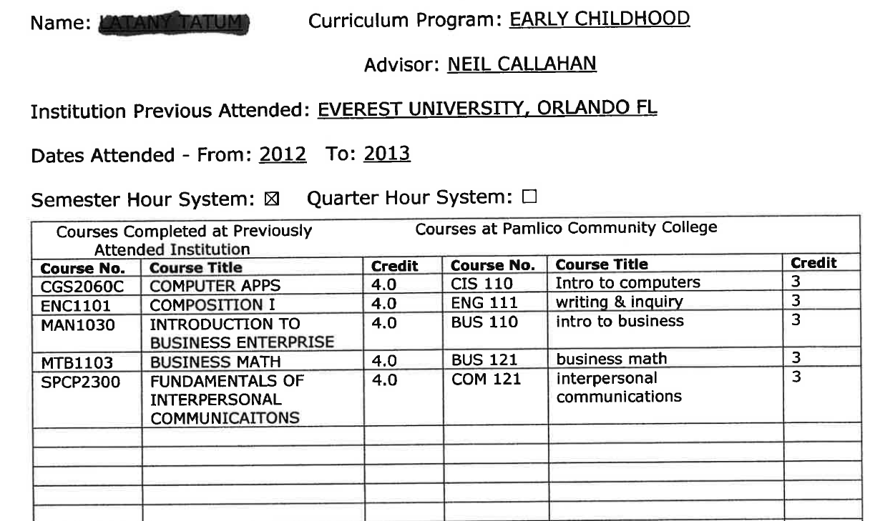

Slide 42
Be mindful of the number of credits the transferring course has.
If the course being transferred in is a 2 credit course, you cannot translate it to a 3 credit course equivalent at PCC.
If you require further help in determining what a course translates into, you can touch base with the subject matter expert.
If you cannot contact the subject matter expert, contact Neil Callahan for assistance.

Slide 43
Substituting for ACA 111/122
In programs that require ACA 122, you can not substitute ACA 111 to satisfy the program requirement.
In programs that require ACA 111, you can substitute courses such as ACA 115, 118, or 122 to satisfy the program requirement.

Slide 44
Questions?

