Slide 1
The Power of Data-Informed Success Coaching
Seth Buchanan, Neil Callahan, Christie Harris, Sarah Hoffarth, Cristy Warner
DISCLAIMER: Content developed under grant P11GX150010 from the U.S. Department of Education but do not necessarily represent the policy of the U.S. Department of Education, and you should not assume endorsement by the Federal Government.

Slide 2
The old reform paradigm has not worked.
Notes:
Anticipated Outcomes
Retention
Persistence
Completion
Return on Investment

Slide 3
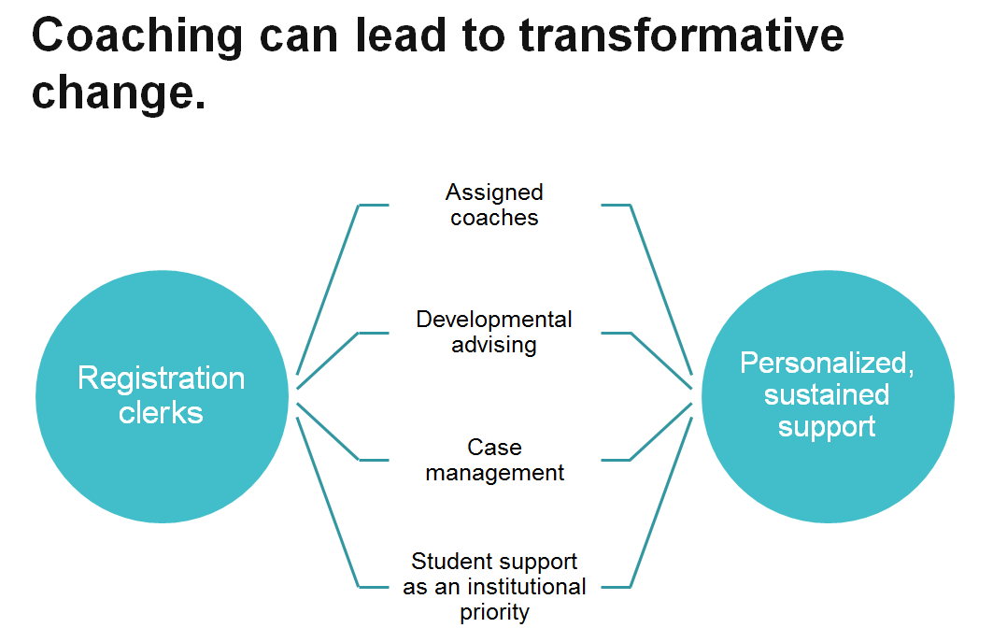

Slide 4
$9.2 million
First in the World grant

Slide 5
Bettinger and Baker (2011)
Random Control Trial
2 years
InsideTrack – Student coaching
Students from public, private, and proprietary universities
Coaching on meta-academic skills

Slide 6
Bettinger and Baker (2011)
Measured persistence and retention at 6, 12, 18, and 24 months
Results were significant
Increased persistence and retention
Results remained significant even after the study concluded

Slide 7
Random Control Trial
Tests causality
Treatment vs. Control
Gold standard for What Works Clearinghouse standards without reservations

Slide 8
Carolina Works-FITW
Measuring persistence, retention, and completion
3 year grant period
2-year college focus
10 North Carolina Community Colleges

Slide 9
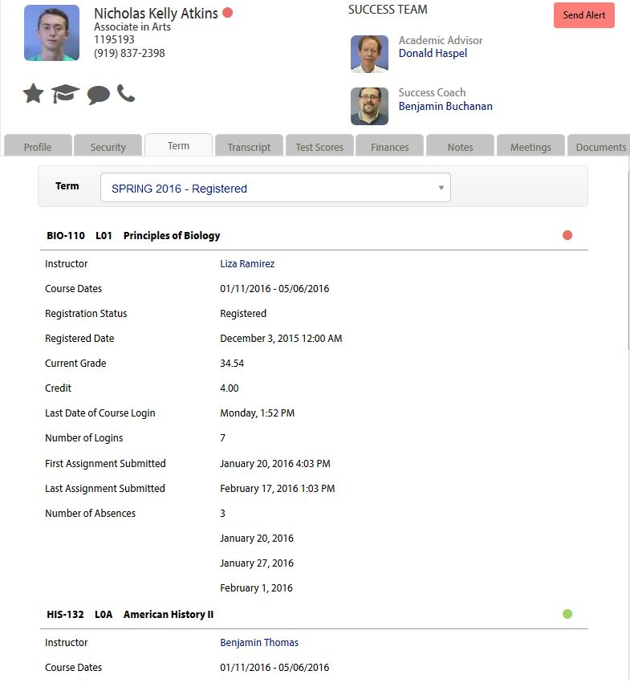
High-risk Students
Determining high-risk using predictive analytic model
Notes:
Department of Education
In 2008, 26% of first-time community college students attained a degree or certificate within 5 years
40% of community college students leave without a credential within 2 semesters

Slide 10
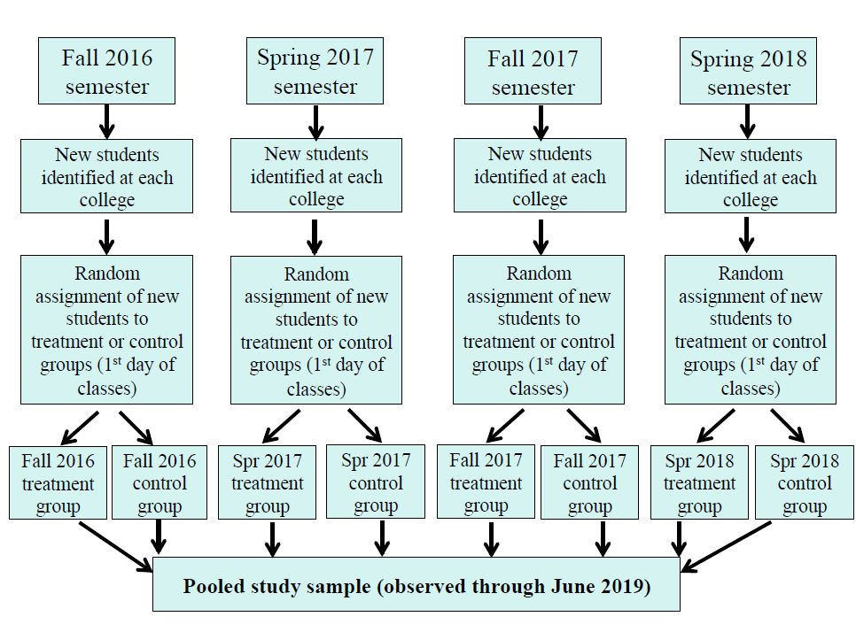
Notes:
Students not enrolled in the prior 3 terms
i.e. Fall 2016 intake (students not enrolled in Summer 2016, Spring 2016, Fall 2015)
Once in the study, students remain in the study
20,000 students

Slide 11
Treatment
Student assigned to a Success Coach
Coach proactively outreaches to student
Coach receives auto-alerts & achievement alerts, and reaches out to student
Coach uses Aviso risk score to inform student outreach
Coach receives staff-generated early alerts, and outreaches to student
Business As Usual
Services already in operation at college Assignment of advisor to student
Academic/Student Success Center Programs serving unique populations (e.g. TRIO)
Other college-specific services
New Aviso functionality Students create profile in Aviso
Students receive auto-alerts from Aviso for attendance, grades, registration
Students receive achievement alerts from Aviso
Students assigned predictive analytic risk score by Aviso

Slide 12
Anticipated Outcomes
Bettinger and Baker (2011) is validated!
Establishment of success coaching as a best practice
Statewide/National model ☺

Slide 13
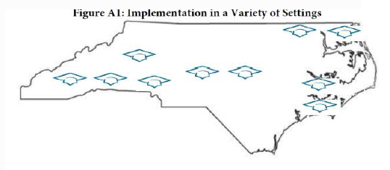
Carolina Works: Partner Colleges
Notes:
Caldwell
Carteret
Cleveland
College of the Albemarle
Isothermal
Pamlico
Randolph
Roanoke-Chowan
Southwestern

Slide 14
Smallest of ten partner schools in Carolina Works project
Located in Rural Eastern North Carolina
Small College with Big Heart and Many Hats
Small college with boating and culinary focus
Located in Eastern North Carolina on the shores of the beautiful Bogue Sound -- part of the Atlantic Intracoastal Waterway.
CARTERET COMMUNITY COLLEGE

Slide 15
Early Implementation Phase
Selection of Leadership Team
Making the Connection with Partners
Divide and Conquer

Slide 16
Team Leadership Workgroup
Overall Project Oversight
Financials
Contractual Agreements

Slide 17
Technology Workgroup
Connection with Data Solution (Colleague)
Connection with LMS (Moodle & Blackboard)
Connection with Student Communication Portal

Slide 18
Success Coach Workgroup
Project Awareness
College Acclimation (keys, phones, stakeholders)
Research-based training readings
Appreciative Advising Model

Slide 19
Status Today
Project Kick-Off Meeting
Fine Tuning
Expected Up and Running Late Summer

Slide 20
Growing Pains
Our Success Moments
Faculty champion
Engaged Leadership Team
Intentional stakeholder engagement
Tie-ins with ongoing projects (CBD, QEP)
The trenches of Student Development work
Confinements of being a Study
Working with Build-as-you-go Technology
Faculty Buy-In
Reworking Student Affairs

Slide 21
Success Coaching Best Practices
What is Success Coaching?

Slide 22
Success Coaching Best Practices
Success Coaching is . . .
“an interactive process that focuses on the personal relationship created between the student and the coach. The coach challenges the student to think about his or her personal and/or professional goals in order to relate them to his or her academic/educational goals. In this learning process, it is important for the coach to encourage the student to become more self-aware by understanding his or her strengths, values, interests, purpose, and passion through proactive outreach.”

Slide 23
Success Coaching Best Practices
Success Coaching is not . . .

Slide 24
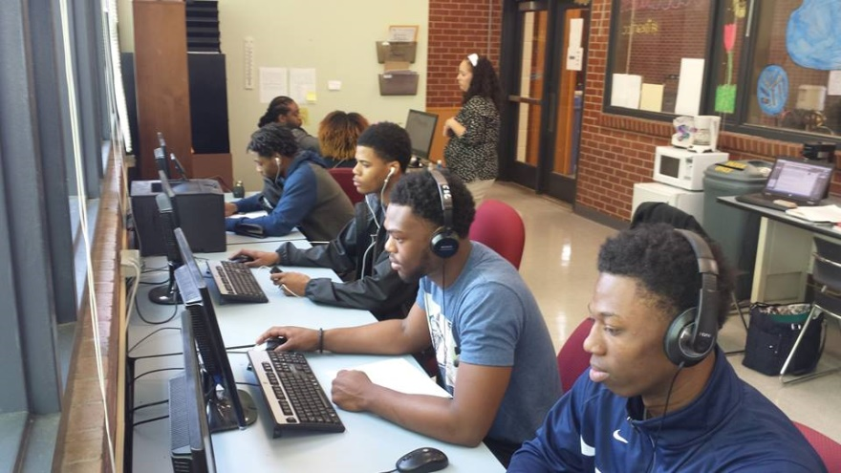
Success Coaching Best Practices
How do we help students?

Slide 25
Success Coaching Best Practices
Start Building your relationship Early!
Introduction
Emails – Caseload Messaging and Messaging by Analytics
Phone Calls
Get out of your office
Proactive Outreach
Don’t Wait –
ACT NOW!

Slide 26
Success Coaching Best Practices
Monitor Student Progress
Current Grade Alerts
Launched Every 4 Weeks
Grade Threshold
On-ground Attendance Alerts
Cut-off varies by class credit hours
Online Attendance Alerts
If student has not accessed course in 7 days
Classes that are exempt
Instructor Issued Early Alerts
Student Outreach
Phone
Email
Wait outside of classroom
Student Center

Slide 27
Success Coaching Best Practices
Aviso is only as good as the information that it brings in:
Blackboard/Moodle
WebAttend
Records Software
If Data areas are not updated regularly, Aviso will provide coaches with bad information.

Slide 28
Success Coaching Best Practices
Single Point of Contact
One-stop Shopping
Coaches know a little bit about EVERYTHING
Who are your Champions?
Financial Aid
Registrar
Student Services
Business Office
Faculty

Slide 29
Success Coaching Best Practices
Put yourself in the student’s shoes
Sent from department to department to get answers
Long waits
Frustration

Slide 30
Success Coaching Best Practices
If a student hand-off has to occur
Escort, if possible
Document everything – Aviso Notes
Avoid the “cell-phone carrier conversation”

Slide 31
Success Coaching Best Practices

Slide 32
Thanks, y’all! Sarah Hoffarth shoffarth@cccc.edu Seth Buchanan sbuchanan@cccc.edu Christie Harris christief0063@Carteret.edu Cristy Lewis Warner cwarner@pamlicocc.edu Neil Callahan ncallahan@pamlicocc.edu
DISCLAIMER: Content developed under grant P11GX150010 from the U.S. Department of Education but do not necessarily represent the policy of the U.S. Department of Education, and you should not assume endorsement by the Federal Government.

