Slide 1

Academic Advising
Professional Development: Part 2

Slide 2

PCC Advising Moodle Site

Slide 3
PCC’s QEP: Focus On Success (FOS)

Slide 4
PCC’s QEP: Focus On Success (FOS)
The Focus on Success Program is PCC’s QEP.
  It focuses efforts on first year student success and retention.
The FOS Program targets three areas:
  New student orientation (face-to-face & online)
  Enhanced academic advising practices
  Placement in success courses (ACA 111 or 122) during the first semester.

Slide 5
To identify if the student is a first year student (FOS), ask the following questions:
  Have you ever taken and received college credits?
  If so, how many (semester credit hours)?
  How long ago did you take these courses?
An FOS student fits one of the following criteria:
  Never attended college before.
  Have not attended college in 5 or more years.
  Earned less than 12 college course credits.

Slide 6
Online & The FOS Student
FOS students (first year students) need to be registered for seated classes whenever possible.
  They will be more successfully during that first semester if you do this.
  FOS students typically do not realize the work and discipline it takes to be successful in the online environment.

Slide 7

  A partial internet course (PI), is a good way to give them a taste of what an online course is like with the benefit of seeing the instructor each week.

Slide 8
Program Certificate, Diploma, and Degree Completion

Slide 9
Program Certificate, Diploma, and Degree Completion
As students move through their program of study, be aware of completion milestones.
  As students complete program certificates and diplomas on their way towards completing their two-year degree, have them apply to receive these as they earn them.
  This is better than letting them wait till the very end to apply for their two-year degree, diploma, and all earned certificates.

Slide 10
Why?
  They may not complete the two-year degree. If not, they may have enough credits for a diploma or certificate.
  It shows PCC has “completers”. The more “completers” PCC has, the better we look as an institution.

Slide 11
When you get a new student, be sure to look over their listed of completed courses on the STAC and PSPR screen in Datatel.
  They may have completed courses at PCC in the past or have transfer credit for courses from other institutions.
  Sometimes these random course credits on their transcript that may add-up to something (certificate, diploma, etc.) in another program.
  Make sure they apply for it if they have not already.

Slide 12
The Process:
  Have the student fill out the “Application for Graduation”. Look for it in Student Services or on the Moodle Advising site.
  Make sure they note which certificates, diplomas, and degrees they are applying for.
  Turn it in to Student Services.

Slide 13
Understand Your Program of Study (POS)

Slide 14
Understand Your Program of Study (POS)
As a subject matter expert (SME), you need to be well versed in your POS.
  POS: Program of Study
  Your POS is based on your Curriculum Standard.
  The Curriculum Standard is developed on the state-level.
Your knowledge of your POS can help students progress quicker towards graduation.

Slide 15
For questions about your Curriculum Standard, contact your state-level subject matter specialist.
  If you are not sure who this person is, please talk with your supervisor to help you find this information.

Slide 16
POS Basics
Your POS has a minimum and maximum number of credits it has to be.
  Minimum: 64 semester credit hours
  Maximum: 76 semester credit hours
Since the implementation of Completion by Design at PCC, your POS semester credit hours necessary to obtain a two-year degree should be close to 64 semester credit hours.

Slide 17
The POS/Curriculum Standard is made up of several categories:
  General education requirements
  Major hours/Requirements
    Aka the “Core”
  Other required/major hours
  See your POS/Curriculum Standard for more details.

Slide 18
Within the POS/Curriculum Standard, certain course requirements are set by the state:
  General education requirements
    There may be some leeway as far as course choices.
  Major hours/Requirements
    Aka the “Core”.
    These can not be changed or substituted.
  See your POS/Curriculum Standard
  for more details.

Slide 19
The rest of the courses are chosen by you to make up the required 64-76 semester credit hours needed for a two year degree.
  These courses are placed under the “Other required/major hours” category.
  These courses have to be chosen from state approved prefixes.
  These courses can be substituted if necessary, following the correct guidelines.
  See your POS/Curriculum Standard
  for more details.

Slide 20
Changes To The POS
Changes to your POS can only be made once during the course of the school year:
  November 30th is the deadline for POS changes. These changes will go into effect the following fall semester.
The process:
  Step one: Present your POS changes to your advisory board for approval.
  Step two: Submit your POS changes to the Instructional Services Committee for approval.

Slide 21
  Step three: Submit to Michelle Willis to share with Dr. Ross for final approval.
  Step four: Submit your approved POS changes to Tammy Spain by November 30th.
Note: Remember to start this process early enough to get all the approvals you need before November 30th.
  The Instructional Services Committee only meets once a month (maybe less now).
  For more details, speak with your supervisor.
If you have additional questions about the process, see registrar, Tammy Spain.

Slide 22
Financial Aid

Slide 23
Financial Aid
When a student has any financial aid questions, refer them to:
  Meredith Beeman: Financial Aid Director
  Do not try to answer financial aid questions. Always refer the student to Ms. Beeman & her staff.

Slide 24
The 12 hours Pell Grant Myth
  You do not have to register for 12 hours to receive financial aid.
  To receive financial aid, you must register for a minimum of 1 semester credit hours.
If a student wants to drop courses and they receive financial aid, suggest they go speak with someone in the financial aid office to see how it will effect them.
  The student already has to go to Student Services anyway to see the counselor to start the drop process.

Slide 25

Meredith Beeman: Financial Aid Director
  Further discussion of financial aid issues.

Slide 26
FERPA: Privacy
The Family Educational Rights and Privacy Act (FERPA) is a federal law that affords parents the right to have access to their children's education records, the right to seek to have the records amended, and the right to have some control over the disclosure of personally identifiable information from the education records.

Slide 27
What you can and can not discuss about a students education record is based FREPA law.
To see who you can and can not speak with, use the STRK mnemonic in Datatel.
  When in doubt about FERPA regulations or if you have questions, please consult the Student Services staff.

Slide 28

STRK: FERPA Information
Tammy Spain, registrar
  See Mnemonics for Advisors Fall 2016 on the Moodle Advising site.

Slide 29
Transcript Information

Slide 30
College Transcripts
Have you taken college courses elsewhere?
  If so, have you had an official transcript sent to the college registrar?
  If not, tell them to contact that college/university and have an official copy sent to the PCC registrar.
  For more details on how to do that, take the student to Student Services.

Slide 31
Ask the student if they have an unofficial copy of this transcript. It will give you an idea of what courses the student needs and does not need while you wait for the official transcript to arrive.
  Avoid registering for those courses. Look at other courses that they need and have never taken anywhere.

Slide 32
  If a course you would like to register the student for has a pre or co-requirement that is showing on the unofficial transcript, you cannot register the student based on this. That information is not official here at PCC till the registrar receives an official copy of the transcript.

Slide 33
  The unofficial copy (photo copy or loose, unsealed original copy) does not take the place of an original, sealed copy. The student still needs to get an official copy sent to the registrar. Once the official copy arrives, the registrar will send you a transcript evaluation. Until you evaluate these courses, they will not be on the student’s PCC transcript and will not count towards graduation.
  If a student hands you an official, sealed transcript, take it to the college registrar. Do not open it.

Slide 34
  If transfer credits are showing on an official transcript from another institution, an official transcript from that particular institution needs to be sent to the PCC registrar as well to be officially added to the student’s PCC transcript and count towards graduation credits.
  For example, my official ECU transcript shows I took ENG 1100 & 1200. The PCC registrar can give credit for those. If that same transcript shows ECU accepted some credits from my time at Craven CC, the PCC registrar needs an official transcript sent from Craven CC to give me credit for those courses here.

Slide 35
Transcript Evaluations
From time to time, the Registrar’s office will send you transcript evaluations that require your immediate attention.
  These outside courses could possibly count toward graduation requirements or pre-reqs. in your program.
  No student wants to waste time and money taking courses that they have already taken.
  These courses do not show up on their transcript until we as advisors complete the evaluation.

Slide 36
In order to determine what the course being transferred translates to here may require some detective work on your part.
  Of course, ACA 111 from Craven CC is ACA 111 at PCC. The registrar inputs these automatically.
  But what is NUTR 1000 from ECU? It’s EDU 153.
Course descriptions are very helpful in determining what a course translates to here.

Slide 37
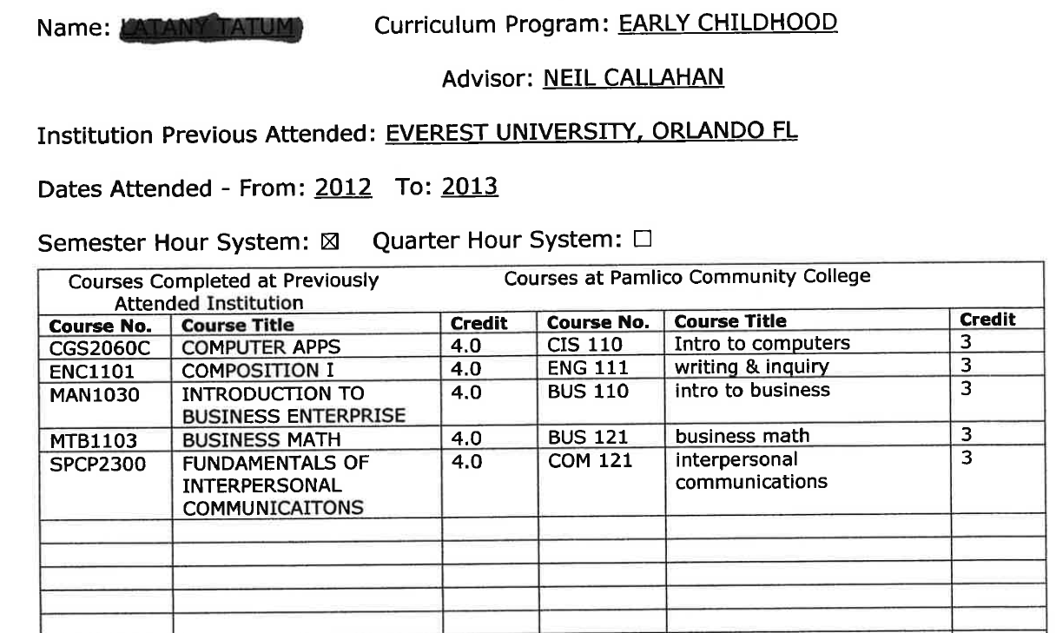

Slide 38
Be mindful of the number of credits the transferring course has.
  If the course being transferred in is a 2 credit course, you cannot translate it to a 3 credit course equivalent at PCC.
If you require further help in determining what a course translates into, you can touch base with the subject matter expert.
  If you cannot contact the subject matter expert, contact Neil Callahan for assistance.

Slide 39
Pamlico County Career Center (JobLink Center )

Slide 40
Pamlico County Career Center (JobLink Center )
As your students approach the end of their program of study, suggest a visit to the JobLink Center.
  The JobLink Center is located behind the Bayboro Center in Bayboro.
  Eric Cedars is the Career Services Director. Mindy Moore is the Career Advisor.

Slide 41
The Pamlico County Career Center provides a convenient location for job seekers and employers to find the employment and training assistance they need.
  Services are provided by partner agencies including the host agency, Pamlico Community College, along with Vocational Rehabilitation, Coastal Community Action, the Division of Employment Services, and the Small Business Center.

Slide 42

Career Center offers the following services for students:
  Help locating employment
  Career counseling
  Resume preparation
  Training
  Career Readiness Certificates, and much more

Slide 43
Tidbits

Slide 44
Campus Cruiser Correspondence
As you advise and teach students, please reinforce the importance of checking Campus Cruiser email.
  PCC communicates many important announcements through the Campus Cruiser email system (financial aid info, for example).
  Not checking these emails can result in many different types of inconveniences for students.

Slide 45
Substituting for ACA 111/122
In programs that require ACA 122, you can not substitute ACA 111, 115, or 118 to satisfy the program requirement.
In programs that require ACA 111, you can substitute courses such as ACA 115, 118, or 122 to satisfy the program requirement.

Slide 46
Aviso & Student Services
As you use Aviso to send Early Alerts and other concerns about students to Student Services, please share with them any feedback you may have.
Contact Jamie Gibbs if:
  You are not happy with the response to your alert.
  You are not happy with the length of time involved with your alert.
  You have other concerns.

Slide 47
Important Course Dates: Fall 2017
Census/10%
Drop Date

Slide 48
Questions?

