Slide 1
Academic Advising
Professional Development: Fall 2018

Slide 2
PCC Academic Advising Mission Statement
Academic advisors at Pamlico Community College provide academic and professional guidance as students develop meaningful educational plans in pursuit of their life goals. Advisors provide students with information about coursework, college policies and procedures, career options, and transfer opportunities. They require student participation in the decision-making process, help students become lifelong learners, and encourage self-reliant problem solving through exploration of students’ own interests and values.

Slide 3
PCC Academic Advising Center
Look under My Courses:
Scroll down to Resources and you’ll find it there.

Slide 4
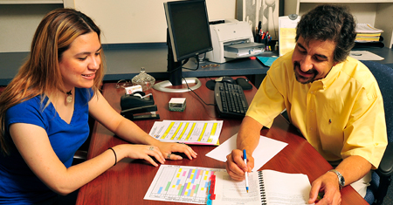
Academic Advising Job Description
Registration is not academic advising.
It is a part of academic advising.
Academic Advising Job Description
See handout.

Slide 5
The Semester Begins

Slide 6
Making Changes
The following changes must be made before the 10% point.
Academic catalog of record
Course substitutions
Program of Study
To start these processes, use the proper forms posted on the PCC Advising Moodle site.
Failure to do so can lead to negative results for students.

Slide 7
WebAdvisor
When your courses begin, as students enter the course (seated or online), please be sure to put an “E” under the date of entry in WebAdvisor.
Do so before the 10% point. Do not wait.
Check your attendance everyday prior to the 10% point.
If students are not attending class, Student Services need to be notified before the 10% point.

Slide 8
If you wait until the 10% point or after, we cannot count the student for FTE purposes.

Slide 9
Census Reports
All fully online courses require students to complete an enrollment verification assignment.
This assignment serves as a way for the student to “enter” the online course.
The census report document must be printed once all students have “entered” the course.
This document serves as proof the student entered the course.

Slide 10
This document must be turned into the college registrar.
Note: I would wait till the day after the census date (the last day to enter the course) to print this document unless everyone has completed the assignment (academic integrity statement).

Slide 11
Phantom Courses: Fall 2018
Courses:
ACA 111 OL1 (B-Term)
ACA 122 OL2
CIS 110 OL1
DRE 096 02 (B-Term: MTW 5:30-8:15 pm)
DRE 097 02 (B-Term: MTW 5:30-8:15 pm)
DRE 098 02 (B-Term: MTW 5:30-8:15 pm)

Slide 12
The students do not know that these sections are available. They are in the system, but will not be published in copies of the Fall schedule that are available to the general public.
In order to register a student for one of these phantom online courses, you must receive prior approval.
Email Neil Callahan: ncallahan@pamlicocc.edu
Be sure to include the student’s name, desired phantom course, and ID number.
Neil will forward your request to Student Services.

Slide 13
Academic Advising Refresher

Slide 14
Not On The Roster
If you have a student show up for your course who is not on the roster, do not allow them to stay in the course.
Ask them to go to Student Services to clear the matter up.
They must do so before entering the course.
If caught doing otherwise, the college could receive a reprimand from the state auditor.

Slide 15
“Front Loading”
“Front Loading”: the practice of registering your advisees for subject-matter courses (taught by you) before properly placing them in foundational courses (as laid out by our QEP and CbD).
Building a strong foundation of basic academic skills leads to retention and completion.

Slide 16
For new and returning (hiatus) students, suggest basic foundational courses such as:
ACA 111 or 122
English (based on test score)
Math (based on test score)
CIS 110
One subject matter (core course) course
What good is taking ACA or ENG courses near the end of your educational pathway?
Skills learned in such courses could have been a lot more useful early on.

Slide 17
Developmental Courses
If your new students test into developmental English or math, place them in these courses during their first semester.
These students have been shown to lack certain skills or they may need a simple skill tune-up in order to be successful moving forward.

Slide 18
Advising For Math
Programs at PCC require different math courses to fulfill the degree math requirement.
In order to help the student fulfill their educational goals, talk to them about their plans.
Do you only desire a 2 year degree or do you plan to pursue a 4 year degree or higher at some point?

Slide 19
This question is important because it will help you advise the student which math course would best meet their educational goals.
Math and college transfer:
MAT 110 is not transferable to a four year college/university.
MAT 143 & 152 are transferable, but some university programs do not prefer it. MAT 152 is typically more transferable than MAT 143.
MAT 171 is transferable and preferred by many more university programs than MAT 143 & 152.

Slide 20
When dealing with a transfer student, check with each individual College/University program to find out more about which transferable community college math they prefer.

Slide 21
Dropping Students (Instructor-Initiated)
Before dropping a student from your course, make sure you have completed an Early Alert in Aviso.
We must have documentation that shows we made an attempt to notify the student of their status.
To drop a student from your course, you must go to Student Services and fill out a Drop/Add form.

Slide 22
Be prepared to list a last day of attendance for the student (unless they never entered the course).
Do not wait too long to drop a student who has:
Not been attending class.
Not been turning in assignments (whether online or face-to-face courses).
Never entered the course (whether online or face-to-face courses).

Slide 23
If you have questions and are not sure if it’s time to drop the student, go to Student Services and talk with someone.
Together you can decide if you have a situation in which a student needs to be dropped.
If the drop is completed before the drop deadline, the student receives no grade (W).
This has no effect on their GPA.

Slide 24
If not, if they are dropped after the drop deadline, the student will receive a grade of “WF”.
It counts as an F and effects the student’s GPA.
The “WF” is a way for Student Services to see that the student has stopped participating in the course as opposed to just not performing well enough to pass (F).
Be sure to include the last date of attendance on the drop form.

Slide 25
Understand Your Program of Study (POS)
As a subject matter expert (SME), you need to be well versed in your POS.
POS: Program of Study
Your POS is based on your Curriculum Standard.
The Curriculum Standard is developed on the state-level.
Your knowledge of your POS can help students progress quicker towards graduation.

Slide 26
For questions about your Curriculum Standard, contact your state-level subject matter specialist.
If you are not sure who this person is, please talk with your supervisor to help you find this information.

Slide 27
Financial Aid
When a student has any financial aid questions, refer them to:
Meredith Beeman: Financial Aid Director
Do not try to answer financial aid questions. Always refer the student to Ms. Beeman & her staff.
Encourage students to prepare their financial aid applications early, for each academic year.

Slide 28
If a student wants to drop courses and they receive financial aid, suggest they go speak with someone in the financial aid office to see how it will effect them.

Slide 29
FERPA: Privacy
The Family Educational Rights and Privacy Act (FERPA) is a federal law that affords parents the right to have access to their children's education records, the right to seek to have the records amended, and the right to have some control over the disclosure of personally identifiable information from the education records.

Slide 30
What you can and can not discuss about a students education record is based FERPA law.
To see who you can and can not speak with, use the STRK mnemonic in Datatel.
When in doubt about FERPA regulations or if you have questions, please consult the Student Services staff.

Slide 31
Transcript Evaluations
From time to time, the Registrar’s office will send you transcript evaluations that require your immediate attention.
These outside courses could possibly count toward graduation requirements or pre-reqs. in your program.
No student wants to waste time and money taking courses that they have already taken.
These courses do not show up on their transcript until we as advisors complete the evaluation.

Slide 32
In order to determine what the course being transferred translates to here may require some detective work on your part.
Of course, ACA 111 from Craven CC is ACA 111 at PCC. The registrar inputs these automatically.
But what is NUTR 1000 from ECU? It’s EDU 153.
Course descriptions are very helpful in determining what a course translates to here.

Slide 33
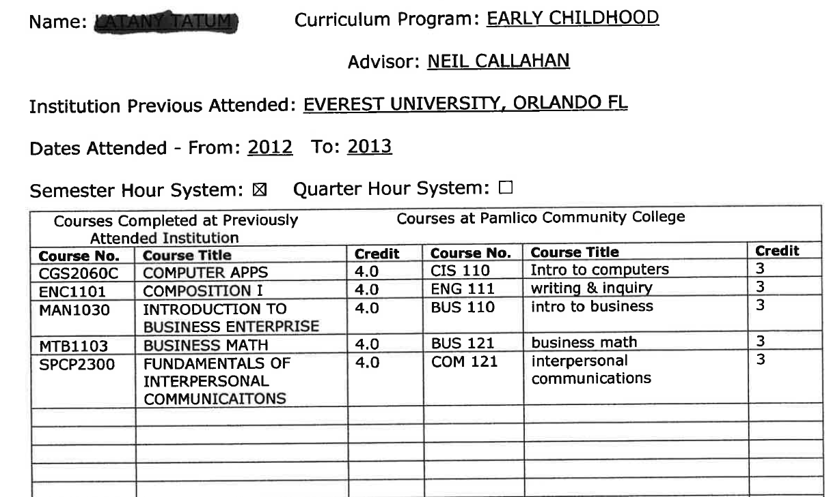

Slide 34
Be mindful of the number of credits the transferring course has.
If the course being transferred in is a 2 credit course, you cannot translate it to a 3 credit course equivalent at PCC.
If you require further help in determining what a course translates into, you can touch base with the subject matter expert.
If you cannot contact the subject matter expert, contact Neil Callahan for assistance.

Slide 35
Aviso Usage

Slide 36
Notes
Use the Aviso Notes function to document interactions with your students.
Document any type of information that would be useful to fellow college personnel.
This running record helps your fellow colleagues better understand the student.

Slide 37
Early Alerts
If you have a student in academic trouble and have exhausted all your means to contact them about the matter, be sure to access Aviso and enter an Early Alert.
Use your good judgement when deciding if you need to send an alert.
Your Early Alert will be received by someone in Student Services.

Slide 38
Remember: Student Services only knows there is a problem if you alert them to it.

Slide 39
Academic Advising Updates

Slide 40
Virtual Transfer Center
Look under My Courses:
Scroll down to Resources and you’ll find it there.

Slide 41
This site contains information and resources related to college transfer from PCC.
Please refer your students to the Transfer site.
They can access it through the PCC website. There is a link within the Student Portal.
Even if they are currently not thinking about college transfer, the student may change their plans a semester or two down the road.
Use the Academic Advising Center as well.

Slide 42
Advising With Transfer in Mind
As you begin preparations for the registration process, please consider using the resources of the transfer center as you advise your students.
Advise with transfer in mind.
Whether you advise AGE, CCP, or AAS degree and certificate students, you can still advise with transfer in mind.

Slide 43
The Transfer Center has links to baccalaureate degree plans (BDPs) for all 16 UNC System schools and many favorite independent colleges and universities across the state.
Copy, date, and save in the students file.
A student can use that BDP date as their catalog year. Continuous enrollment rules apply.
Honored by UNC System colleges if student is accepted within four years of community college start date.

Slide 44
Contact independent colleges or look over the ICAA Document to see how they handle such matters.
As an academic advisor in several areas (AA, SECU-PE, & EDU), I try to have discussions with my advisees about their future educational plans.

Slide 45
If one of my AA students, for example, expresses interest in attending Western Carolina to pursue a degree in Sports Management, we pull up the BDP for that degree program and try to tailor AA course choices to fit what Western requires as well.
In the AA degree program, a student can complete the math requirement by taking MAT 143, 152, or 171. Which math course does Western prefer for Sports Management? They prefer MAT 152 for their math requirement in that degree program.
Please keep things like this in mind as you advise students for registration.

Slide 46
Review Transcripts (Give Them Credit)
As you advise, or prepare to advise, your students, be sure to look over their transcript in Datatel Colleague using the PSPR function.
Once you have printed a copy of the student’s transcript information using the PSPR function, look for the section at the end of the document called “Other Courses.”

Slide 47
In this section, you may find courses the student has taken here or elsewhere that have not been filtered into the program requirement sections on the PSPR transcript.
Examine these courses carefully because you may find a course that can be used as a program requirement.
To know for sure, always refer to your Curriculum Standard, located on the NCCCS website.

Slide 48
If you have further questions about whether the course can be used as a program requirement, consult the college registrar, Tammy Spain (3011).

Slide 49
Putting Grades in the Gradebook
As you grade assignments and enter them into your Moodle gradebook, always enter a grade for each assignment.
Do not leave the grade blank.
If the student has not submitted an assignment on time and has permission to submit the assignment late, enter the grade of zero.

Slide 50
Once you receive the assignment, grade it, subtract the late fee, and enter the new grade.
If the student never follows through with submitting the work, you have that covered (you entered the zero). The student gets to keep it.
By having a grade entered into the gradebook, the student has a true sense of how well they are doing in a course.
This process also helps Aviso function, as it should.

Slide 51
False averages, due to non-grading or missing grades, can result in a student missing out on opportunities to correct course issues as early as possible.

Slide 52
Pre-Registration
When the time comes each academic year, please take the time to pre-register as many of your students as you can, especially for fall courses.
This helps give us an idea of how numbers are looking going into the next academic semester.
Pre-registering students improves student retention from semester to semester.
It helps identify course needs as well.

Slide 53
Student Needs/Issues
If you feel one of your students has a need or an issue going on in their life that they may need some guidance to address beyond what you can do, please refer them to Student Services.
The Student Services staff are able to help students in many different areas.
Promise Place may always be an option as well.

Slide 54
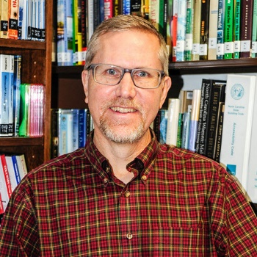
Tutoring & Success Center
As the semester progresses, if you have students in need of help to better enhance their academic skills, please refer them to the PCC Library.
The PCC Library offers:
Tutoring services
The Student Success Center

Slide 55
Pirate Promise: ECU Co-Admission
PCC and East Carolina University recently approved a new co-admission agreement.
Under the agreement, interested students will apply to PCC and ECU simultaneously.
Participating PCC students also will be eligible to receive:
Joint academic advising and financial aid counseling.
Access to ECU’s libraries, student activities, and other benefits.

Slide 56
For more details, see Neil Callahan.
This option applies directly to our Associate in Arts and Associate in Science Programs of Study.
As for how this option applies to AAS Programs of Study offered at PCC that have separate articulation agreements in place, further investigation will be required.
Neil Callahan serves as PCC/ECU point of contact.

Slide 57
NC Promise Program
The NC Promise Tuition Plan reaffirms the state’s commitment to make the university experience affordable and accessible to all.
Through NC Promise, the state will significantly reduce student tuition cost at three UNC system institutions:
Elizabeth City State University
University of North Carolina at Pembroke
Western Carolina University.

Slide 58
RISE
RISE: Reinforced Instruction for Student Excellence
Students will be placed into one of three pathways based primarily on their HS GPA
It will replace prerequisite remediation (DMA/DRE) with corequisite remediation
The goal is to increase the number of students that successfully pass a gateway math and English within two years.
More information will follow. See the PCC Academic Advising Center.

Slide 59
Important Course Dates: Fall 2018
Census/10%
Drop Date

Slide 60
Questions?

